Slide 1

Financing Universal Social Protection in Developing Countries
A Session at the Civil Society Forum at the Annual Meetings of IMF and World Bank,
11 October 2017, 1:45-3:15 pm
Margaret Grosh
Senior Adviser, Social Protection and Jobs Global Practice

Slide 2
Promoting the principles of Universal Social Protection (USP) → a joint initiative of the WB, ILO, donors and other partners launched in Sep. 2016 and aimed at providing social protection for all people in need;
Contributing to the Sustainable Development Goals (SDG) agenda:
SDGs Goal 1 → to end (extreme) poverty in all its manifestations by 2030; ensure social protection for the poor and vulnerable;
Target 1.3 → implement nationally appropriate social protection systems and measures for all, including floors, and by 2030 achieve substantial coverage of the poor and the vulnerable;
Target 1.5 → build the resilience of the poor and those in vulnerable situations and reduce their exposure and vulnerability to climate-related extreme events and other economic, social and environmental shocks and disasters;

Slide 3
Social Protection - Activities
Social Protection
Social Safety Nets/Social Assistance
(Non contributory)
To prevent and protect from risks and shocks
Social Insurance
(Contributory)
To ensure adequate living standards in the face of shocks and life changes
Labor Market Programs
(Contributory and non contributory)
(To promote labor inclusion and reintegration)
Unconditional cash transfers (UCT)
Conditional cash transfers (CT)
Non-contributory social pensions
Food and in-kind programs
School feeding
Public works and food for works
Fee waivers and targeted subsidies
Other social assistance
Active labor market programs
Passive labor market programs
Contributory pensions
Other social insurance

Slide 4
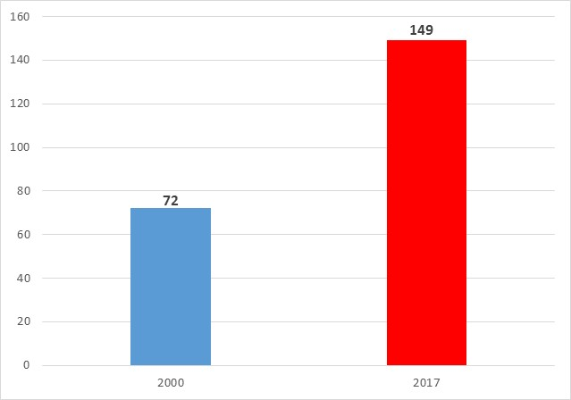
The number of low income developing countries and emerging market economies with social safety nets/social assistance programs doubled in the last two decades → from 72 to 149 countries;
Figure: Number of developing countries & emerging market economies with social safety net/social assistance programs
Source: Atlas of Social Protection: Indicators of Resilience and Equity (ASPIRE) database -- www.worldbank.org/aspire.

Slide 5
Most countries have a diverse set of social safety nets/social assistance instruments in pursuit of greater results
Figure: Number (share) of developing countries and emerging economies with Social Safety Net/Social Assistance instrument
Source: Atlas of Social Protection: Indicators of Resilience and Equity (ASPIRE) database -- www.worldbank.org/aspire.
Notes: The total number of countries used in the calculation of percentages is 158.

Slide 6
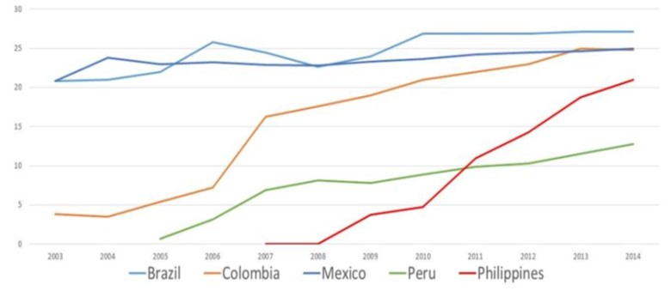
What we see around the world is a rapid and substantial increase in coverage
→ e.g. in Colombia, Peru and Philippines the coverage of conditional cash transfer (CCT) programs has increased from 5% of population at the program inception to more than 15-20% a decade later;
Figure: Coverage of CCTs in selected countries, % of population
Source: Atlas of Social Protection: Indicators of Resilience and Equity (ASPIRE) database -- www.worldbank.org/aspire.

Slide 7
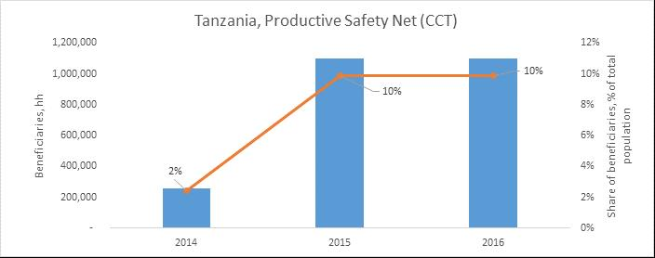
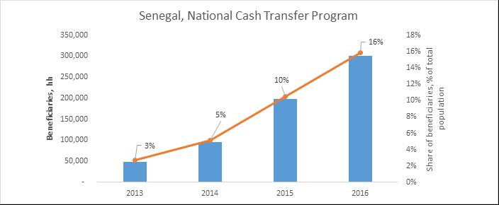
What we see around the world is a rapid and substantial increase in coverage
→ many countries in Africa are introducing “flagship” SSN programs and are expanding their coverage fast;
Figure: The expansion of the flagship Social Safety Net programs in Tanzania and Senegal
(N of beneficiary HHs and % of population covered)
Source: Atlas of Social Protection: Indicators of Resilience and Equity (ASPIRE) database -- www.worldbank.org/aspire.
Notes: Bars (blue) indicate number of beneficiaries (households); line (orange) indicates % of population covered by the program.

Slide 8
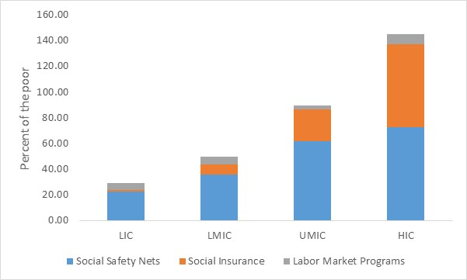
However, more needs to be done as significant gaps in coverage remain around the globe
→ especially in low-income countries, where only 20% of the poor are covered by social safety nets/social assistance programs;
Figure: Coverage of the poor (bottom 20%) by social safety nets/social assistance programs
Source: ASPIRE database.
Notes: LIC – Low Income countries; LMIC – Lower Middle Income countries; UMIC – Upper Middle Income countries; HIC – High Income countries.

Slide 9
More also needs to be done as significant gaps in adequacy remain around the world → especially in low-income countries, where social assistance/safety net transfers leave a substantial (17%) poverty gap;
Figure: Poverty gap pre vs. post social safety net/social assistance transfer, % of international poverty line
Source: Atlas of Social Protection: Indicators of Resilience and Equity (ASPIRE) database -- www.worldbank.org/aspire.
Notes: LIC – Low Income countries; LMIC – Lower Middle Income countries; UMIC – Upper Middle Income countries; HIC – High Income countries. Poverty gap refers to the distance between household per capita welfare (consumption/income) and a poverty line. For the non-poor, this gap is equal to zero.

Slide 10
Globally, developing countries and emerging market economies spend an average of 1.6% of GDP on social safety nets/social assistance programs; however, significant variations in spending are observed across countries/regions
Figure: Spending on Social Safety Net programs across the regions, % of GDP
Source: Atlas of Social Protection: Indicators of Resilience and Equity (ASPIRE) database -- www.worldbank.org/aspire.
Notes:
We have comparable data over time for ECA and LAC only 2003 to 2015:
ECA 1.2 to 1.8 to 1.6
LAC .5 to 1.5
We note that 50% of African SSN are donor financed.

Slide 11
Growing financing of and engagement in social protection projects; the size of the World Bank’s social protection lending portfolio has increased substantially in the last few years;
Figure: The size of the World Bank’s Social Protection lending portfolio, US$ billion
Source: World Bank Operations Portal.

Slide 12
Focusing resources on IDA and fragility, conflict & violence countries; for the first time the World Bank’s social protection lending is higher in IDA rather than in IBRD countries; IDA is now 50% of total portfolio;
Figure: The size of the World Bank’s social protection lending by country status, 2017, US$ billion
Figure: The size of the World Bank’s social protection portfolio – commitment from IDA
as a financing source, FY13-FY16, US$ billion
Source: World Bank Operations Portal.
Notes: IDA – International Development Association; IBRD – International Bank for Reconstruction and Development.

Slide 13
SPL public action is still constrained by myths and competition for resources:
CSO work to build societal knowledge and consensus would be very welcome
Myths to dispel, Positive Ideas to spread: e.g.:
from “the poor are lazy, handouts make them lazier” to “most poor work, income support often releases constraints and makes them more productive and/or builds the health and education of their children”
From ‘the poor spend resources unwisely’ to ‘the poor spend their income support on more and better food, often more health or education, and if there is enough, on savings or investments in their enterprises’.
We have ample and growing evidence on these things. How do we get policymakers and societies to know and believe them?
There are policy choices to make and consensuses to build:
More universal and more costly? Or more narrowly targeting and lower fiscal cost? What mix? Where is the sweet spot on solidarity?
When and how are countries willing to confront either additional taxes or reforms of general subsidies or other programs to make space for USP?

