Slide 1

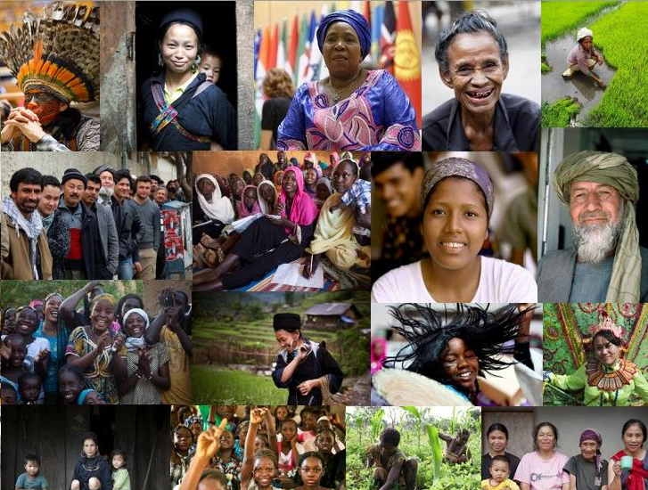

Inequality, exclusion and social protection
Maren Jiménez
Division for Inclusive Social Development
12 February 2020

Slide 2
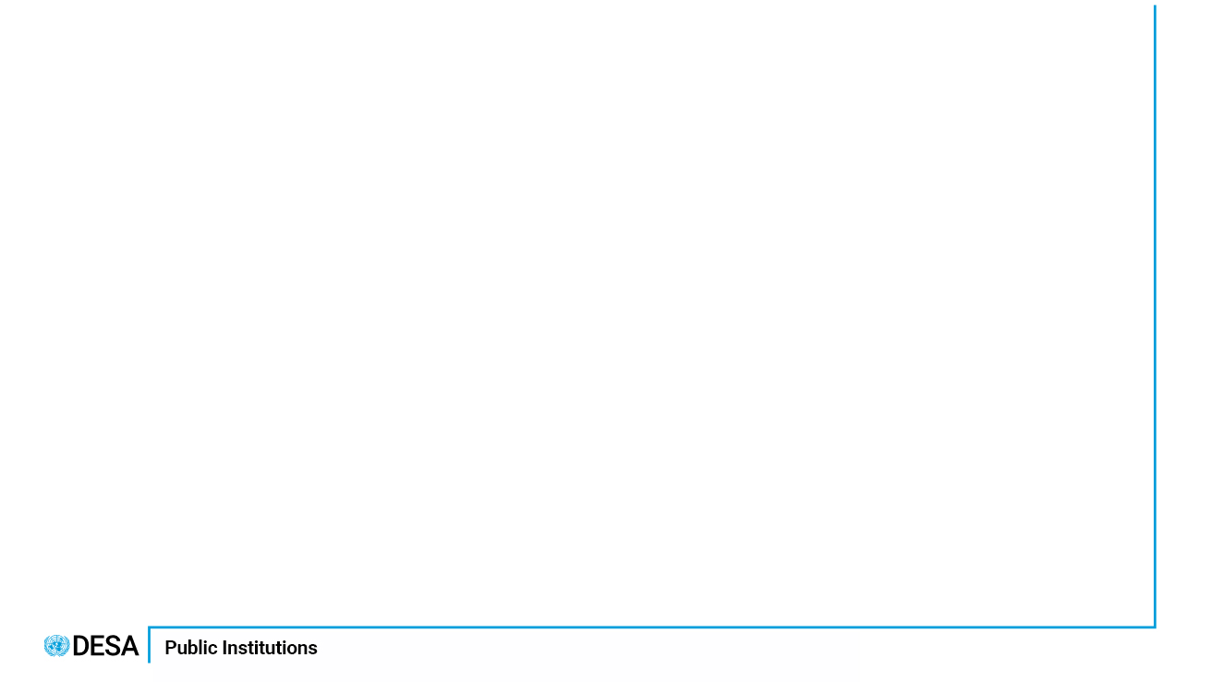

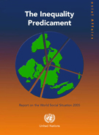
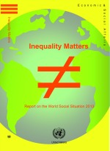
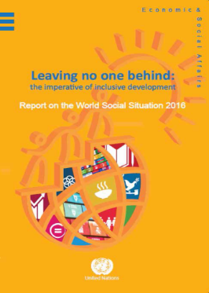
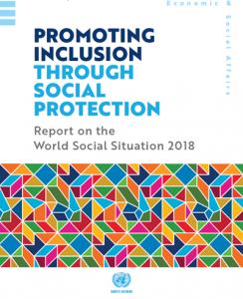
World Social Report
(previously the Report on the World Social Situation)
UN flagship publication on social issues since 1952
social.un.org/worldsocialreport
Social inclusion

Slide 3
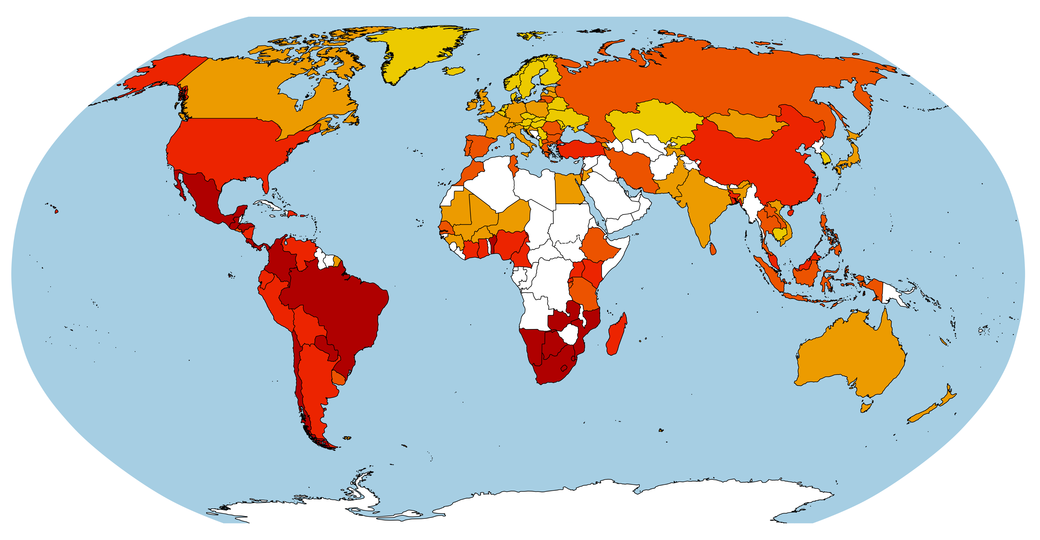
Income inequality today
Social inclusion

Slide 4
Beyond income and wealth:
group-based (horizontal inequality)
Identity also influences economic outcomes and well-being
  Group-based inequality constitutes a large component of overall inequalities within countries
      Also tend to be more persistent over time than economic inequality
  Inequalities based on identities overlap, e.g. age, gender and disability status
Social inclusion

Slide 5
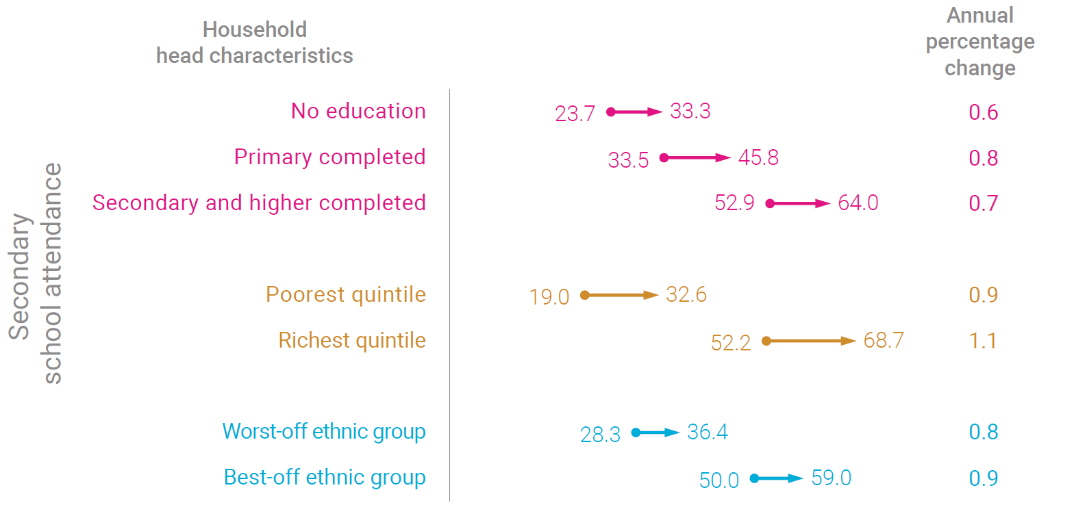
Inequality between groups still vast and increasing
Social inclusion

Slide 6
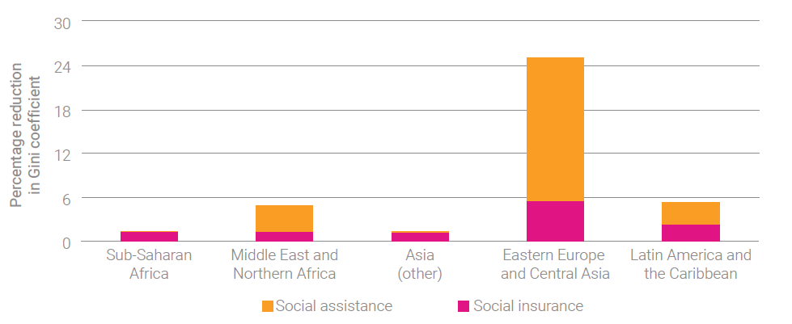
Impact of social protection on the Gini coefficient
Social inclusion

Slide 7
Common barriers to the effective coverage of social protection
Informal employment: youth, persons with disabilities, migrants, members of ethnic minorities, especially women
Location: some indigenous peoples and ethnic minorities, migrants
Policy formulation, design and implementation: contributory and tax-financed measures (non-contributory); targeted vs. universal; conditional vs. non-conditional; registration and payment; accessible information).
Social inclusion

Slide 8
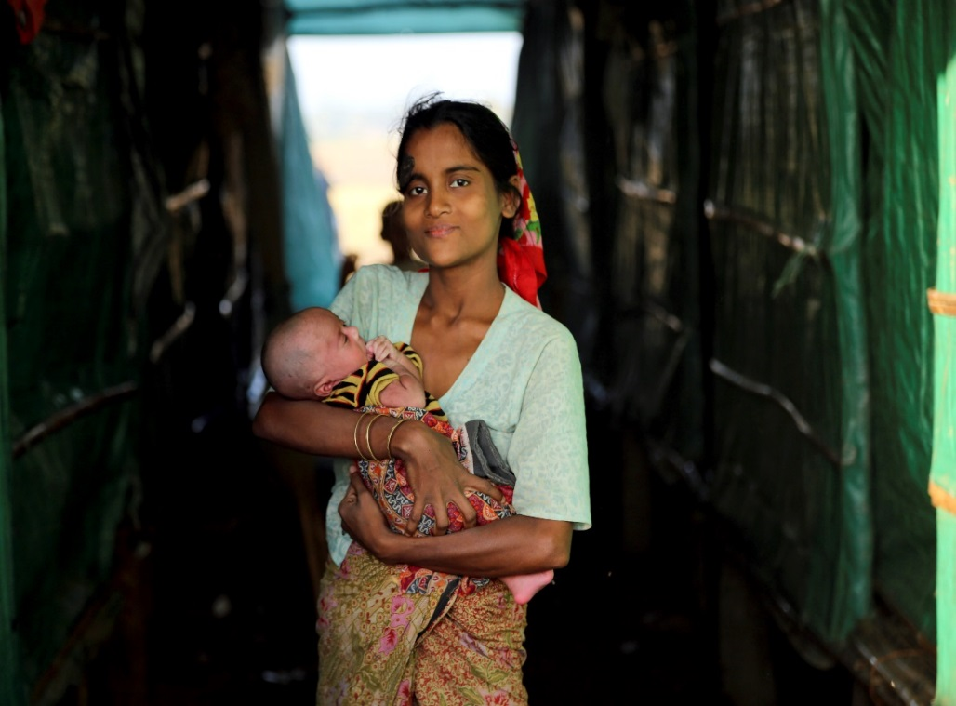
Universal social protection that offers benefits to all is a step in the right direction
Credit: Stephen Devereux, IDS
Credit: UN Photo
But not complete answer!
Must be available and accessible
Social inclusion

Slide 9
Social protection alone cannot achieve social inclusion
Doesn’t address stigma and discrimination
Needs to be linked to appropriate and adequate social services
Also: There remains a general lack of data on social protection
Social inclusion

Slide 10
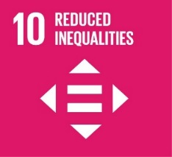
Three takeaways
High and rising inequality in many parts of the world, but inequality is not only income and wealth—IDENTITY MATTERS, especially for children
Universal social protection is a crucial tool for the reduction of poverty and inequality, but MIND THE GAP!
Social protection alone cannot achieve social inclusion
Social inclusion

Slide 11
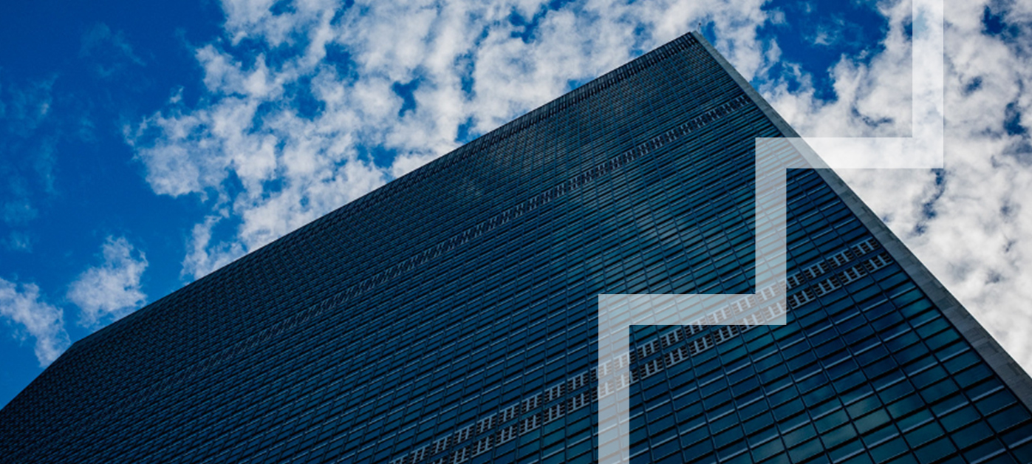
Thank you.

