Slide 1
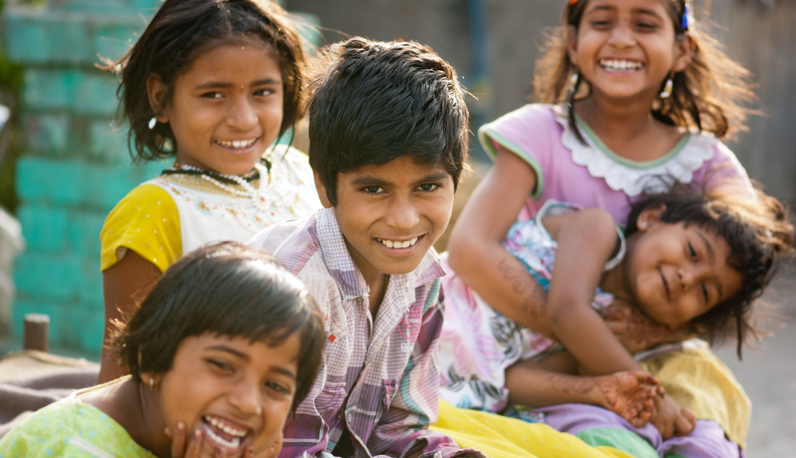
The right of all to roofs and floors: affordable housing and social protection
Side event “The right of all to roofs and floors: affordable housing and social protection”
UN Commission for Social Development
New York, 12 February 2020
  Christina Behrendt, ILO Social Protection Department, Geneva

Slide 2

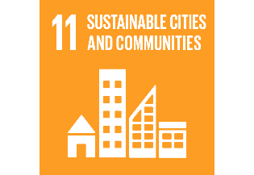
More efforts are needed to realize the rights to social security and an adequate standard of living, including adequate housing, for all
Social security is a human right, but…
Adequate housing is a human right, but…
Interconnections
  SDG indicator 1.3.1
  SDG indicator 11.1.1
55%
  of the world population is not covered by at least one social protection benefit (SDG indicator 1.3.1)
23%
  of the world’s urban population lives in slums
  (SDG indicator 11.1.1)
4 billion people are still unprotected
Lack of access to adequate housing:
          Material and social aspects
          Systemic discrimination and social exclusion
          Rights-holders agency and participation

Slide 3
Effective social protection systems can prevent poverty and facilitate access to adequate housing
Figure 1: Social protection expenditure (including health, percentage of GDP) and percent of population living on less than $3.2 per day, latest available years
Source: World Social Protection Report 2017-2019 (ILO, 2017) and PovcalNet (World Bank, 2019, data accessed in May 2019).
Figure 2: Effective social protection coverage (SDG indicator 1.3.1) and urban population living in slums (SDG indicator 11.1.1), 2014/2015
Source: ILO World Social Protection Report 2017-2019 (ILO, 2017) and UN-Habitat (2019, data accessed in May 2019).

Slide 4
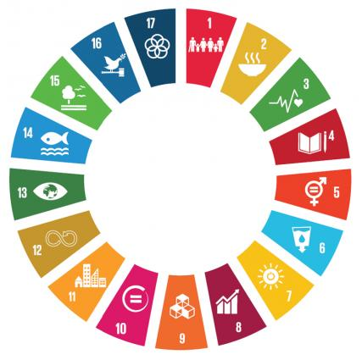
Social protection in the Sustainable Development Agenda
to leave no one behind: interconnecting SDGs
SDG1: End poverty in all its forms
1.3: Social protection systems and measures for all, including floors
SDG16: Peace, justice and strong institutions
16.6: Develop effective, accountable and
transparent institutions at all levels
SDG3: Ensure health lives and promote well being for all at all ages
3.8: Achieve universal health coverage
SOCIAL PROTECTION
SDG5: Achieve gender equality and empower all women and girls
5.4 Recognize and value unpaid care and domestic work
SDG11: Make cities and human settlements inclusive, safe, resilient, and sustainable
11.1: Ensure access to adequate, safe and affordable housing and basic services and upgrade slums
SDG6: Ensure availability and sustainable management of water and sanitation for all
6.2 Achieve access to adequate and equitable sanitation and hygiene for all
SDG10: Reduce inequality within and among countries
10.4: Adopt policies, especially fiscal, wage, and social protection policies, and progressively achieve greater equality
10.7 Facilitate orderly, safe, regular and responsible migration and mobility of people
SDG8: Promote decent work and economic growth
8.5: Achieve full and productive employment and decent work for all women and men, including for young people and persons with disabilities, and equal pay for work of equal value

Slide 5
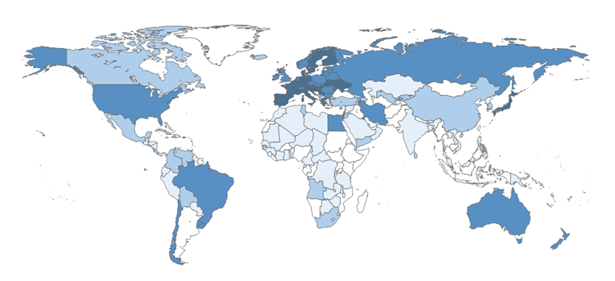
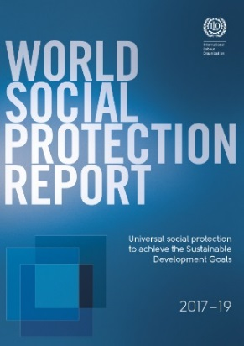
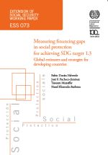
One major challenge: Underinvestment in social protection
          Coverage gaps are associated to underinvestment in social protection
          Negative impacts of austerity or fiscal consolidation cuts: narrow-targeting or eliminating schemes
          Cost estimate: 527 billion US$ would be needed to finance a set of social protection floor cash benefits in developing countries
  Public social protection expenditure, excluding health, latest available year (percentage of GDP)
Less than 5 per cent
From 5 to less than 10 per cent
From 10 to less than 15 per cent
15 per cent and above
No data
Source: ILO, World Social Protection Report 2017-19

Slide 6
The importance of a social protection floor… and more!
International framework provided by ILO Recommendation, 2012 (No. 202)
Social protection floor guarantees
          Everyone has access to essential health care, including maternity care
          All children enjoy basic income security, providing access to nutrition, education, care, and any other necessary goods and services
          All persons in active age who cannot earn sufficient income, enjoy basic income security, particularly in cases of sickness, unemployment, maternity, disability
          All older persons enjoy basic income security
          Anchored in human rights framework
          and reflected in SDGs 1.3 and 3.8
high
Social protection system
(nationally defined)
  Vertical dimension: progressively ensuring
  higher levels of protection, guided by Convention No.102 and
  more advanced standards
voluntary
insurance/savings under gov. regulation
level of protection
social protection benefits
of guaranteed levels
(usually social insurance)
social protection floor: basic income security
and access to health care for all
Social insurance
low
low
individual/household income
high
  Horizontal dimension:
  Guaranteeing access to essential health care
  and minimum income security for all,
  guided by Recommendation No. 202

Slide 7
Universal social protection is not only about coverage:
The framework set out in the ILO Centenary Declaration for the Future of Work (2019)
Adapted to developments in the world of work:
Ensuring that systems are constantly improved and adapted to respond to a changing economic and
social context; supporting labour mobility and
life and work transitions, as well as the
structural transformation of the economy.
compre-hensive
adequate
sustainable
adapted
to the world
of work
universal
Universal coverage (persons protected):
Closing coverage gaps in an inclusive way: no one
should be left behind; respect for people’s rights and dignity; non-discrimination, gender equality and responsiveness to special needs
SOCIAL PROTECTION
Comprehensive protection (risks covered): Providing comprehensive protection throughout the life course, including income security and access to health protection.
Sustainable and equitable financing:
Financial, economic and social sustainability based on the principles of solidarity; transparent, acountable and sound financial governance; balance of interest between those who benefit and those who finance the system.
Adequate protection:
Adequate protection goes beyond just reducing poverty – it should prevent poverty, and guarantee social security and an adequate standard of living in line with human rights and ILO social security standards.

Slide 8
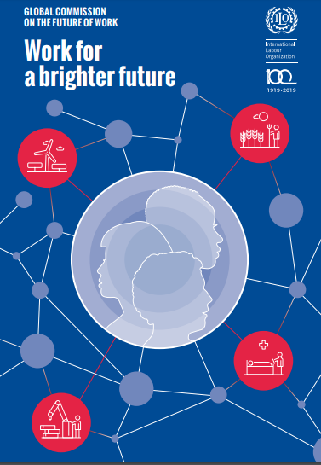
Some fundamental policy choices for the formulation and implementation of social protection policies and strategies
Encouraged
Mandatory coverage
Large risk pool
High-quality benefits and services, easy access
Simplified administrative procedures, harnessing digital technology
High transparency and accountability, high trust
Unified/coordinated system
Integrated policy framework
Sufficient fiscal space using a good mix of contribution and tax financing
Broad and well-informed social dialogue
Discouraged
Voluntary coverage
Small risk pools
Low quality and poor access to benefits and services
Complex and cumbersome administrative procedures
Low transparency and accountability, low trust
Fragmented schemes
Isolated/disconnected policies
Inadequate financing framework
No social dialogue

Slide 9
Accelerating progress towards universal social protection and the SDGs:
Six key policy messages
    Accelerating progress towards universal social protection
    Extending coverage and ensuring inclusiveness
    Ensuring comprehensive protection to address the full set of risks throughout the life course
    Ensuring adequate quality of benefits and services
    Ensuring that social protection systems are
    gender-sensitive and responsive to special needs, including for people with disabilities.
    Promoting people’s rights and dignity, anchored in internationally agreed framework of human rights instruments and ILO standards.
    Promoting participation and social dialogue in formulating, implementing and monitoring social protection policies and ensuring coordination with other policies, including housing policies.
    Ensuring sustainable and equitable financing of social protection systems, and where necessary increasing fiscal space for social protection, based on the principles of risk sharing and solidarity.
    Strengthening and adapting social protection systems to ensure that they effectively support people in their life and work transitions.

Slide 10
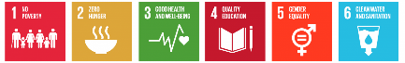


We have only 10 years
to make social protection
a reality for all
2030

Slide 11
Further references
ILO publications
    Social protection systems for all to prevent homelessness and facilitate access to adequate housing, Social Protection for All Issue Brief (ILO, 2019).
    World Social Protection Report 2017-19: Universal social protection to achieve the Sustainable Development Goals (ILO, 2017).
    Measuring financing gaps in social protection for achieving SDG target 1.3: Global estimates and strategies for developing countries (Durán-Valverde et al., 2019)
    Universal social protection for human dignity, social justice and sustainable development (ILO, 2019).
    Building social protection systems: International standards and human rights instruments (ILO, 2017).
    Towards universal social protection for children: Achieving SDG 1.3 (ILO and UNICEF, 2019).
    Global Commission for the Future of Work: Work for a brighter future (ILO, 2019).
    Policy resource package on extending social security to workers in the informal economy (ILO, 2019)
International labour standards and frameworks
    Social Protection Floors Recommendation, 2012 (No. 202)
    Social Security (Minimum Standards) Convention, 1952 (No. 102)
    Workers' Housing Recommendation, 1961 (No. 115)
    Transition from the Informal to the Formal Economy Recommendation, 2015 (No. 204)
    ILO Centenary Declaration for the Future of Work, 2019
Web platforms
    Social Protection Platform:
    www.social-protection.org/
    Global Partnership for Universal Social Protection: www.USP2030.org
    Joint UN web platform on social protection and human rights: www.socialprotection-humanrights.org
Contact: behrendt@ilo.org

Slide 13

Global Partnership for Universal Social Protection to Achieve the Sustainable Development Goals (USP2030)
Background: Launched in 2016 at the
United Nations General Assembly in New York
USP2030 partners: World Bank and ILO (co-chairs), other multilateral and bilateral development partners, UN Member States, trade unions, civil society organizations.
Joint mission: A world where anyone who needs social protection can access it at any time.
Objective: To increase the number of countries that provide universal social protection, in line with SDG target 1.3: “Implement nationally appropriate social protection systems and measures for all, including floors, and by 2030 achieve substantial coverage of the poor and the vulnerable.”
Call to Action
ACTION 1. Protection throughout life cycle: Establish universal social protection systems, including floors, that provide adequate protection throughout the life cycle;
ACTION 2. Universal coverage: Provide universal access to social protection and ensure that social protection systems are rights-based, gender-sensitive and inclusive, leaving no one behind;
ACTION 3. National ownership: Develop social protection strategies and policies based on national priorities and circumstances in close cooperation with all relevant actors;
ACTION 4. Sustainable and equitable financing: Ensure the sustainability and fairness of social protection systems by prioritizing reliable and equitable forms of domestic financing, complemented by international cooperation and support where necessary;
ACTION 5. Participation and social dialogue: Strengthen governance of social protection systems through institutional leadership, multi-sector coordination and the participation of social partners and other relevant and representative organisations, to generate broad-based support and promote the effectiveness of services.

Slide 14

Join !
Who? Countries or organizations that
fully support the objectives and vision of the partnership, and
contribute to its realization through global advocacy, knowledge exchange, country support and implementation
Why? Benefits of joining USP2030 include:
Global network of key actors with cutting-edge expertise around universal social protection and SDG target 1.3
Exchange of country experiences
Engagement in a global forum for knowledge building and sharing, bringing together all relevant stakeholders
Shaping the global social protection agenda
How? More information available at https://www.usp2030.org/,
including the Call to Action and information on How to Join USP2030
Or contact the secretariat of USP2030: secretariat@usp2030.org

