Slide 1
Homelessness Globally
What? How? Where? Why?
Joanna Padgett Herz - IGH UN Project Coordinator

Slide 2
How has homelessness been defined by the UN?
It hasn’t. But some definitions have been implied...
Those lacking shelter to live in because of poverty
Refugees
Diasporas
Marginalized communities who have experienced historical atrocities
Those whose shelter had been destroyed by natural disasters - “rendered homeless by....”

Slide 3
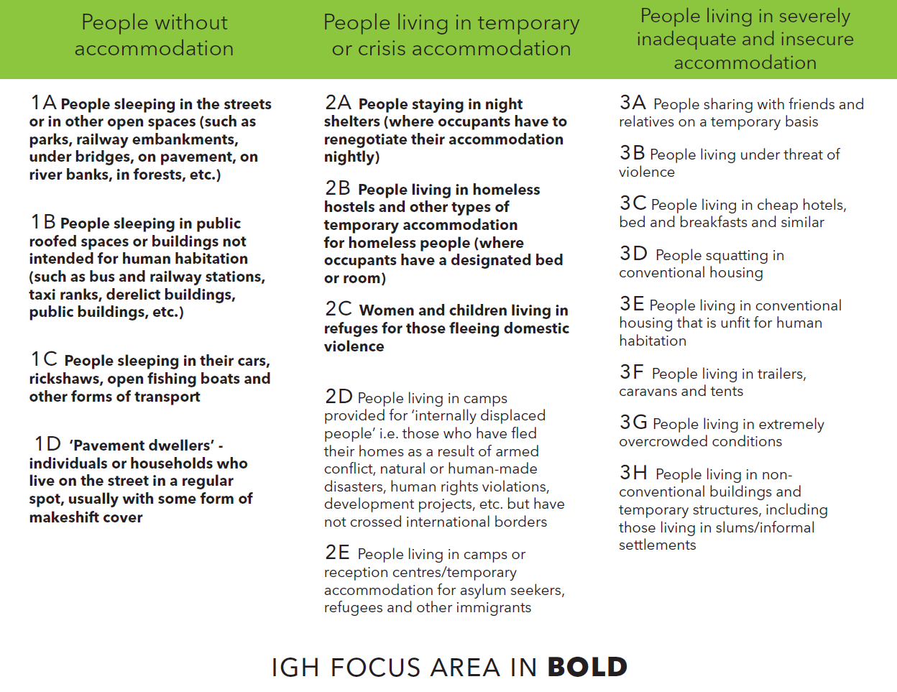
What is homelessness?
“Homelessness is a condition where a person or household lacks habitable space with security of tenure, rights and ability to enjoy social relations, including safety. Homelessness is a manifestation of extreme poverty, and a failure of multiple systems and the implementation of human rights.”
Using this definition we identify four broad categories of homelessness:
People living on the streets or other open spaces;
People living in temporary, emergency or crisis accommodation;
People living in severely inadequate or insecure accommodation; and
People who lack access to affordable housing.” - Civil Society Declaraion

Slide 4
How do people become homeless?
Poverty - cycles of poverty
Lack of affordable housing - housing market instability
Domestic abuse
Discrimination and violence
War
Migrant and refugee status
Mental health concerns
Lack of adequate housing

Slide 5
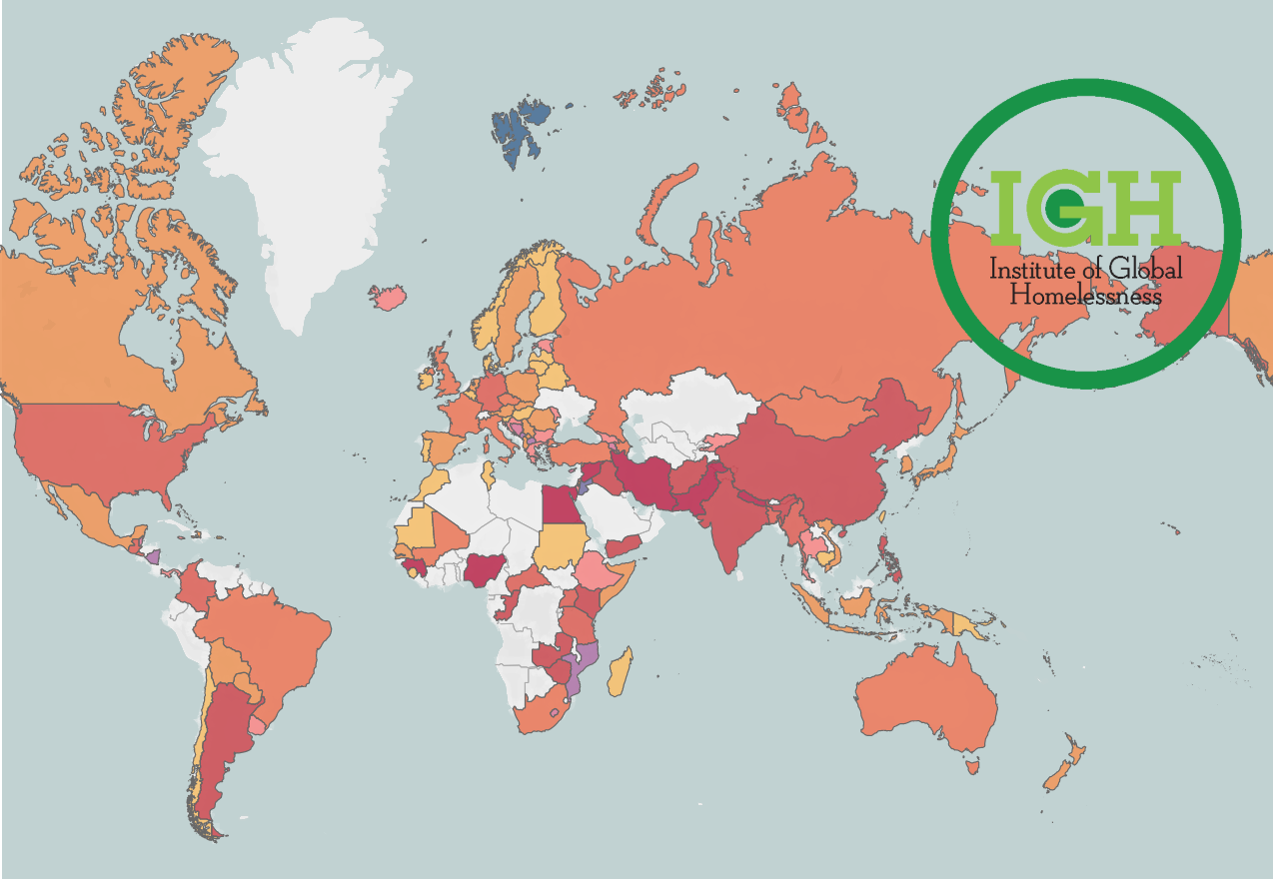
Where are people homeless? How many people are homeless?
Current global data on homelessness is inconsistent and unreliable.

Slide 6
How are countries measuring homelessness?
Australia - via a street count
Russia - via a census
“A person who is in a dwelling that is inadequate; or has no tenure, or if their initial tenure is short and not extendable; or does not allow them to have control of, and access to space for social relations.”
“Data was collected using records about residences or housing payments.”

Slide 7
Why is measurement and definition so important?
Because we need to know...
Which gender(s) are most likely to be homeless?
Which races/ethnicities are most likely to be homeless?
Are parents more or less likely to be homeless? Are they single or together?
Are children often homeless without parents?
What age group is most likely to be homeless?

Slide 8
Why is measurement and definition so important?
Because without it, we can’t...
Identify trends in rates of homelessness
Identify what does and does not affect the rates of homelessness
Begin reducing homelessness globally
Determine necessary social protection systems to implement to end homelessness

Slide 9
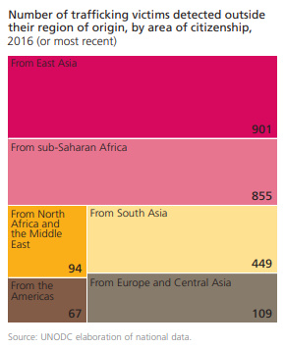
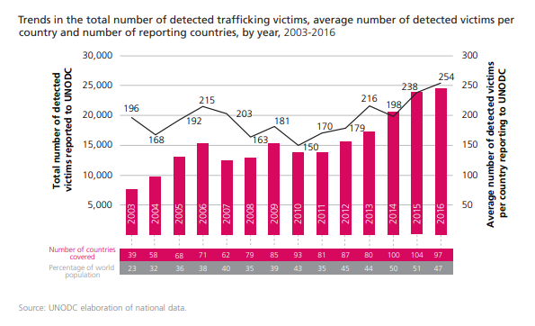
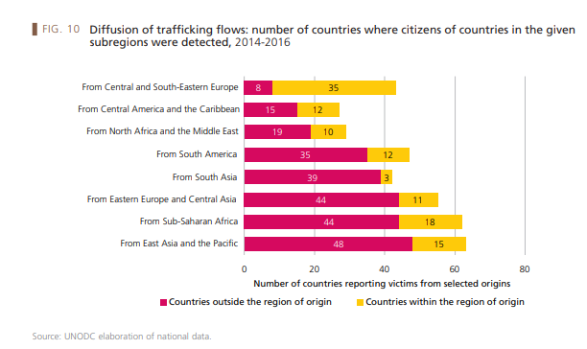
2018 Global Report on Trafficking in Persons
What UN global measurement can do

