Slide 1
Ending Homelessness is possible; the Finnish approach
CEO Juha Kaakinen
UN, New York
12.2.2020

Slide 2
Homelessness in Finland
In recent years Finland has been the only EU country where homelessness has decreased*
Situation in 2018: 5.482, 4.882 single homeless persons, 600 in families
Wide definition of homelessness: 70−75 % living temporarily with friends and relatives, low amount of rough sleeping (283)
From 2008 to 2018: long-term homelessness has decreased 21%, 2018: 1.162
* FEANTSA

Slide 3
Phases of Homelessness Policy in Finland
1)1985-2007: Several National Programmes
Welfare legislation
Building new social housing (preventing family homelessness)
Supported housing as part of a staircase model
2) 2008-2015: Ending Longterm Homelessness
Housing First as the main principle
From temporary to permanent housing
3) 2016-2019: Programme for Prevention

Slide 4
Housing options for Homeless persons in Helsinki
Year | Supported housing | Independent rental apartments | Hostels and shelters | Social housing apartments
1985 | 127 | 65 | 2.121 | 35.404
2008 | 552 | 2.033 | 558 | 68.881
2016 | 1.309 | 2.433 | 52 | 67.764

Slide 5
Housing First in Finland
Housing as a basic human and social right
Housing in normal surroundings/permanent homes
Own independent rental apartment either in scattered housing or in a supported housing unit
Own rental contract (normally for unlimited time)
Adequate support including housing benefit
Autonomy/ unconditionality
Normality

Slide 6
You can’t have Housing First
without having housing …
first.

Slide 7
Väinölä
Supported housing
33 apartments (35 tenants)
Opened 2014
Built by Y-Foundation
Leased to City of Espoo
Support provided by Salvation Army (11 co-workers)

Slide 8
What made it possible?
Political will: A national policy with an action oriented program
Wide partnership between state authorities, ministries, cities and NGOs
Prevention:
Affordable housing (at least 25% in new housing areas)
Housing for groups with special needs
Basic social and health services including housing advisory service
Basic income security including housing benefit

Slide 9
What made it possible?
Measures to end homelessness:
Implementing Housing First as a systemic model
Renovating existing shelters and hostels into supported housing with indivudual flats
Providing housing from several sources:
Affordable social housing, new supported housing blocks, flats acquired from the private market
Adequate support based on intensive case management and use of basic social and health services
Basic income security including housing benefit

Slide 10
What is needed to end homelessness?
Political will
Housing First as the mainstream policy, as a systemic model
From temporary to permanent housing solutions
Alternative housing solutions and tailor-made support
Affordable social housing (structural prevention)
Method of implementation:
Wide partnership
Concrete measurable quantitative goals
Short timespan from decision to execution
Basic income security (including housing benefit) and basic social and health services

Slide 12
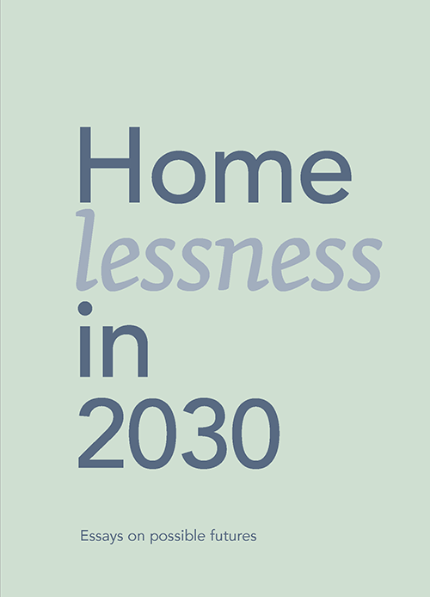
Thank you!
A Home of Your Own − Housing First and ending homelessness in Finland
Download for free: ysaatio.fi/the-book
juha.kaakinen@ysaatio.fi
Twitter: @JKaakinen
Homelessness in 2030 − Essays on possible futures
Download for free: ysaatio.fi/homelessnessin2030

