Slide 1

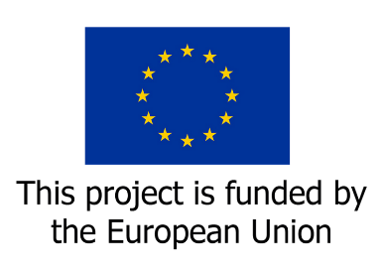



Civil Society Training on Public Finance Management for Social Protection
Global Coalition for Social Protection Floors
This Civil Society Training Manual on Public Financial Management for Social Protection is part of the Programme “Improving synergies between Social Protection and Public Finance Management", funded by the European Union.
This document was produced with the financial assistance of the European Union. The views expressed herein can in no way be taken to reflect the official opinion of the European Union.

Slide 2
WHAT IS PUBLIC FINANCE MANAGEMENT (PFM)?
Public Finance Management is a process of
Mobilizing revenue,
Allocating funds,
Undertaking public spending efficiently, effectively, transparently, and with equity.
The aim, from a civil society perspective, is to deliver satisfactory social outcomes for the well-being of people.

Slide 3
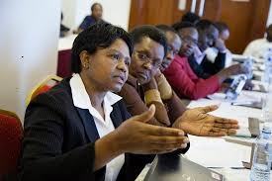
Civil Society and Trade Union Advocates Have A Crucial Role to Play
They must ensure that social protection is well integrated into the PFM process.

Slide 4
Crucial Role of Civil Society and Trade Union Advocates
They must remind their governments that social protection is central to the realization of important national economic and social goals: economic growth, sustainable development, decent livelihoods and wellbeing for national populations.

Slide 5
Purpose of the Training Session
To explore the basic concepts, processes and tools that underpin public finance management.
Through presentations and interactive discussion, to demonstrate their relevance for the strengthening of social protection systems, and for the progressive universalizing of social protection regimes.
Training sessions will be conducted virtually, at country level, in the four participating countries of the GCSPF EU-DEVCO project: Improving Synergies between Social Protection and Public Finance Management, namely: Cambodia, Nepal, Senegal, and Uganda.

Slide 6
Main Components of the
Training Session
Introduction to resource materials,
Illustrative examples of relevant country experiences,
Guide questions,
Accompanying glossary of terms.
All are meant to inform and to stimulate highly interactive discussions in which participants will share relevant experiences and learn from each other and from facilitators.

Slide 7
Desired Outcomes
At the end of the session, CSO/TU advocates and activists will be better equipped to engage with their governments and institutional partners.
The aim is to develop capacity for effective participation in dialogues on the building and strengthening of social protection regimes, on sustainably financing them, and on monitoring for desired results, all with a PFM lens.

Slide 8
The PFM Process
PFM can be conceived as a process in six phases.
These correspond, essentially to the six phases of the annual budget cycle.
Note, however, that the full PFM cycle typically goes beyond the annual budgetary cycle, and is more often a multi-year process.

Slide 9
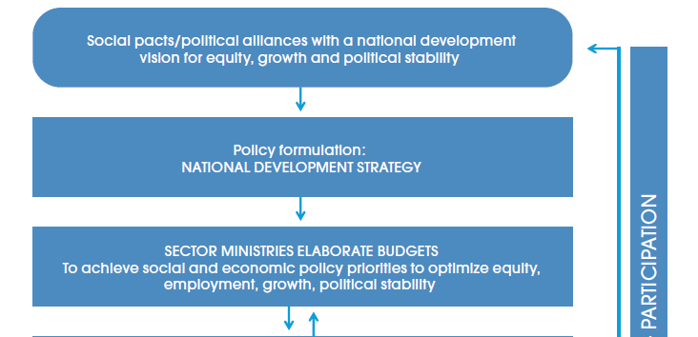
The PFM Process –
The Government Budget Cycle-Figure 1

Slide 10
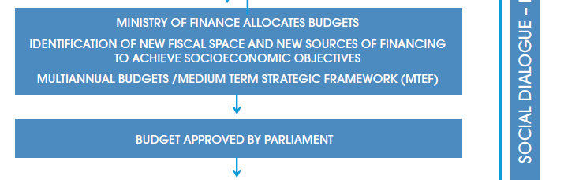
The PFM Process –
The Government Budget Cycle-contd.

Slide 11
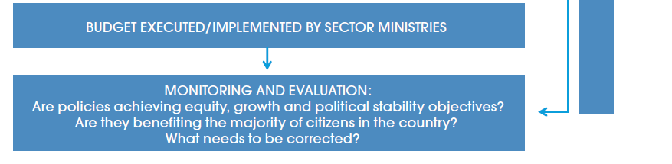
The PFM Process –
The Government Budget Cycle-contd.

Slide 12
Multi-stakeholder Dialogue and the Annual Budget Cycle
An important point to note:
The budget cycle, as outlined in Figure 1, makes provision for multi-stakeholder dialogue and participation as a cross-cutting activity, relevant to every phase.
The degree to which this goal is realized may depend upon the civic space available in any given country.

Slide 13
PFM Principles make provision for multi-stakeholder dialogue
Provision for multi-stake holder dialogue is consistent with the following PFM principles:
Budget documents and data should be public, transparent and accessible. The budget cycle should follow due process, applying checks and balances as an accountability mechanism.
Debate on budgetary choices should be inclusive, participative and realistic.
(Refer to slides 44-46 for 9 PFM principles).

Slide 14
Review of the Budget Cycle
[Refer to Figure 1]
Phase 1.
The Office of the President/Prime Minister supported by the Ministry of Finance (MOF) typically leads the Phase 1 policy formulation activities.
Guiding documents on sustainable development, economic and social strategies may be assembled and discussed, harmonized and prioritized.

Slide 15
Review of the Budget Cycle contd.
The aim at this stage is to arrive at a common vision for:
the national development strategy,
the medium-term expenditure strategy,
and the annual budgetary process.

Slide 16

How can CSOs/Trade unions engage in Phase 1 of the budget cycle?
An instructive example comes from Uganda:
The Government of Uganda is currently reflecting on whether the country should be establishing a Social Protection Floor.

Slide 17
CSO/Trade union engagement in Phase 1 of the budget cycle contd.
The subject of a social protection floor is very relevant to Phase 1 of a future budget cycle: “Policy Formulation towards a National Development Strategy”.
The current EU-DEVCO GCSPF Project is committed to supporting CSO/trade union participation in national dialogues aimed at defining a vision for a social protection floor.

Slide 18
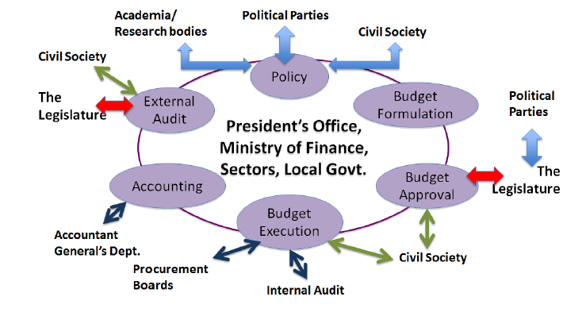
Phase 1 of the Budget Cycle.
Topic for Discussion
Has your CSO/Trade union network been engaged in policy dialogues with your government on defining a vision and broad goals for universalizing social protection, such as through establishing/strengthening a social protection floor?

Slide 19
Review of the
Budget Cycle contd.
Phase 2. [Refer to Figure 1]
At the second phase, sector ministries set their priorities and submit their plans and annual budgets.
A large number of actors engage in the budgetary cycle at this stage, in so far as policy space and procedural practice allow.
The aim of these actors is to ensure that the process operates effectively and transparently while maintaining accountability (all important PFM principles), and that it incorporates important societal priorities from their perspective.

Slide 20


Illustration of Phases 1 and 2 of the Budget cycle:
The Project Documents for Nepal and Senegal discuss the importance of promoting shock-responsive approaches to social protection.
The aim is to ensure adequate and predictable funding for services to affected populations in times of crisis.

Slide 21
Shock-responsive approaches to Social Protection contd.
These activities in Nepal and Senegal illustrate what is involved in Phases 1 and 2 of the budget cycle: Policy formulation, and elaboration of sectoral budgets.
In Nepal, the focus has been on natural disasters, and a workshop was organized by UNICEF on this topic at the inception phase of the EU-DEVCO/GCSPF project, in which CSOs participated.
In Senegal, the focus has been on the crisis of food insecurity, and the need to address this through social protection programmes.

Slide 22
Applying shock-responsive approaches to the Covid-19 crisis
The Covid-19 crisis has served to highlight the need to incorporate shock-responsive approaches to social protection from the outset, that is, at the policy-formulation phase of the budget cycle (Phase 1).
Shock-responsive systems should have a strong answer to how to fund the accompanying programmes, so they could effectively incorporate adaptive mechanisms to cater to the needs of those experiencing vulnerability, such as expanding food banks to address food insecurity, or mobilizing emergency funds for expanded cash transfer programs.

Slide 23
Guide topic and questions on shock-responsive approaches to social protection
CSOs/trade unions may wish to seek opportunities to discuss with their government, the latter's perspectives on shock-responsive social protection.
Has your network had any dialogues with the government or institutional partners (UNICEF, ILO, the IMF country mission), on the question of shock-responsive social protection?
What shocks should the government prepare for? What services should it offer in response to a shock? Does it have or need to develop the administrative and financial capacity to respond appropriately?

Slide 24
Review of the
Budget Cycle contd.
Phase 3 [Refer to Figure 1]
At the third phase of the budget cycle, the budget authority allocates annual allotments to government departments, agencies, and possibly to sub-national authorities.
Through an iterative process, they reach agreement on a national budget, broken down in different ways:
by programme sector,
ministry operations,
contributions to sub-national level,
line by line.

Slide 25
Critical need for advocacy at Phases
2 and 3 of the Budget cycle
Phases 2 and 3 of the budget cycle are critical for CSO/Trade union advocates.
They should seek opportunities to advocate for increased allocations to underfunded areas in social protection budgets, with a view to meeting the critical needs of vulnerable populations,
They should advocate for the progressive extension of coverage under the nine contingencies of social security.

Slide 26
The Nine Contingencies of Social Security
References: The Social Security (Minimum Standards) Convention 102 of the International Labour Organization (ILO, 1952), and the Maintenance of Social Security Rights Convention 157, (ILO, 1982).
These Conventions provide a framework for pursuing comprehensive social security and social protection coverage by identifying nine contingencies over the life course, requiring provision of benefits to the affected citizens of a country.

Slide 27
The Nine Contingencies of
Social Security contd.
Governments should ensure the following provisions:
medical care,
sickness benefits,
unemployment benefits,
old-age benefits,
employment injury benefits,
family/child benefits,
maternity benefits,
invalidity/disability benefits and
survivors’ benefits

Slide 28
Guide question on Phases 2 and 3 of the budget cycle
Phases 2 and 3 deal with budget elaboration and budget allocation.
Has your CS/TU network engaged with relevant sector ministries concerning your priorities with regard to issues such as:
design,
coverage in relation to the nine contingencies of social security, and
funding of social protection programmes.

Slide 29
Review of the
Budget Cycle contd.
[Refer to Figure 1]
Phase 4. During this phase, the budget is approved after parliamentary debate and possible revision.
Phase 5. At this stage allocations are made, and programmes are implemented.
Phase 6. During this phase, programmes are evaluated for their performance in relation to goals and targets.

Slide 30
Illustration of Phases 5 and 6 of the Budget cycle: Implementation, and Monitoring & Evaluation
The Nepal EU-DEVCO/GCSPF Project document reports that research has revealed many coverage gaps and exclusion errors in the delivery of social protection.
These anomalies affect, most notably, benefits to persons with disabilities (PWDs), and child grants. The present Project plans to focus on support to the Government of Nepal in "strengthening the system…” of service delivery in order to overcome these challenges.

Slide 31
Illustration of Phases 5 and 6 of the Budget cycle contd.
Support initiatives (of the EU-DEVCO project) will focus on:
identification of beneficiaries,
registration,
payment,
monitoring and reporting.
The aim is to expand coverage and reduce exclusion errors, focusing also on improving the registration process, timely payment and real time monitoring of the child grant and the disability grant.

Slide 32
Illustration of CSO/TU Entry points into Phases 5 and 6 of the Budget cycle
Working alongside UNICEF and ILO to realize the project objectives (of the current EU-DEVCO project) could provide the CSO/Trade union network with entry points into discussions with the government in phases 5 and 6 of the PFM cycle, Implementation, and Monitoring & Evaluation.

Slide 33
Illustration of CSO/TU Entry point into Phase 5 of the Budget cycle
Included in Implementation are grievance-handling/redress mechanisms which are reportedly weak, and thus in need of strengthening.
CSOs/trade unions could advocate for strengthened grievance/redress mechanisms.
CSOs/TUs could use these mechanisms to support workers, families, vulnerable populations and other target groups within communities, to assess the coverage and quality of service delivery, and to bring issues for redress to the attention of the relevant agencies and service providers.

Slide 34
Illustration of CSO/TU Entry point into Phase 6 of the Budget cycle
The Project Document for Senegal reports that UNICEF has supported the Ministry of Economic Planning and Cooperation in the creation of the Social Budget Monitoring Observatory (OSBS).
This activity is relevant to Phase 6, Monitoring and Evaluation.
The aim is to generate the evidence needed to advocate for an increased budget to the social sector, thus, also providing a feed-back loop to Phase 2, elaboration of sectoral budgets, for a subsequent budget cycle.
CSOs/Trade unions may wish to utilize existing monitoring mechanisms such a the OSBS to generate their own evidence for avocacy on financing of priority areas in social potection.

Slide 35
Guide questions on Phases 5 and 6 of the Budget cycle
Has your CS/TU network engaged in monitoring of implementation of social protection programmes, for example regarding:
adequacy of coverage,
exclusion errors in registration,
grievances among recipients and
use of redress mechanisms?
[Refer to the experience of Nepal].

Slide 36
Guide question on Phase 6 of the Budget cycle
Do monitoring mechanisms exist for tracking beneficiaries' access to programmes and services in specific sectors?
If yes, do your network members make use of them to assess quality and adequacy of service delivery, and to generate the evidence base for advocacy on social protection?
[Refer to the experience of Senegal].

Slide 37
Achieving fiscal space to maintain and scale up social protection programmes
Fiscal space has been defined by the IMF as “the availability of budgetary room that allows a government to provide resources for the desired purpose without any prejudice to the sustainability of a government’s financial position.”
Expanding fiscal space for social protection is essentially about finding opportunities to mobilize additional revenue and to allocate additional funds to social protection expenditure.

Slide 38
Understanding the concept of expanding fiscal space
It is important for CSOs/TUs to understand the concept of expanding fiscal space . It is key to their advocacy strategies for increased financing of social protection.
In this regard, they must develop the arguments to back their calls for governments to fulfill their human rights obligations and their commitment to achieve the Sustainable Development Goals(SDGs).

Slide 39
Expanding fiscal space – the antidote to fiscal consolidation
CSOs/TUs must insist that their governments make every effort to ensure that social protection programmes are maintained, despite economic downturns in times of crisis.
Governments should not cut back on pre-planned social protection expenditure in the name of austerity or fiscal consolidation. Rather, they should explore options for expanding fiscal space.

Slide 40
What is Fiscal Consolidation?
Fiscal Consolidation refers to the set of austerity measures used by many governments to reduce budget deficits following times of crisis (economic downturns, natural disasters, public health crises such as the COVID-19 pandemic).
Primarily, it involves cuts in public expenditure, in particular social expenditure (health, education, the wage bill, social protection).
[Refer to the definition of “fiscal consolidation” in the accompanying Glossary of Terms].

Slide 41

Illustration of CSO/TU engagement in initiatives to expand fiscal space
The CSO/trade union network in Cambodia plans to engage in dialogue with relevant government bodies to explore the question of expanding fiscal space for increased social protection coverage for informal economy workers under the NSPPF (National Social Protection Policy Framework).

Slide 42
CSO/TU initiative to expand fiscal space contd.
In the context of this initiative, a particular emphasis will be placed on women workers.
On the revenue side, the capacity of informal economy workers to contribute to the social insurance scheme will be explored by means of a survey.
This activity of the CSO/TU network in Cambodia is relevant to overall policy formulation, in particular fiscal policy.
It can therefore be used as a relevant entry point into Phase 1 of an upcoming budgetary cycle.

Slide 43
Guide question on strategies to expand fiscal space
Has your CS/TU network been involved in policy dialogue with your government on the question of expanding fiscal space to increase coverage of social protection programmes?
[Refer to the experience of Cambodia, Slides 41-42].

Slide 44
Essential Principles of
Public Finance Management (PFM)
A well-functioning PFM system should be informed by the following 9 principles:
Budgets should be managed within clear, credible and predictable limits to ensure a sustainable fiscal policy. The maintenance of fiscal discipline is an important objective of a PFM system. It should ensure that levels of tax collection and public spending are consistent with targets for the fiscal deficit and avoiding unsustainable levels of public borrowing.
2. Budgets should be closely aligned with the medium-term strategic priorities of government, responding to national development objectives for all citizens

Slide 45
Essential Principles of PFM contd.
3. Budget documents and data should be open, transparent and accessible. The budget cycle should follow due process, applying checks and balances as an accountability mechanism.
4. Debate on budgetary choices should be inclusive, participative and realistic .
5. Budgets should present a comprehensive, accurate and reliable account of the public finances .
6. Budget execution should be actively planned, managed and monitored.

Slide 46
Essential Principles of PFM contd.
7. Performance, evaluation and “value for money” should be integral to the budget process.
8. Longer-term sustainability and other fiscal risks should be identified, assessed and managed prudently
9. The integrity and quality of budgetary forecasts, fiscal plans and budgetary implementation should be promoted through rigorous quality assurance including independent audit

Slide 47
Benefits of good public finance management for social protection
While engaging with governments and institutional partners on specific areas of social protection, it is important to keep these overall principles in mind, with a view to assessing PFM performance in relation to social protection.
Social protection systems underpinned by good public finance management can help ensure predictable budget allocations, timely budget execution, better financial accountability and transparency.

Slide 48
Monitoring and Evaluation (M&E)
Monitoring and Evaluation (M&E) of implementation constitutes a critical phase in the budgetary cycle.
Applied to social protection programmes, it helps to reveal:
the strengths and weaknesses of the social protection system,
the funding shortfalls and coverage gaps,
the level of effectiveness and efficiency of social delivery,
the adequacy of benefits to end-users,
the effectiveness of strategies along the cycle from policy formulation through revenue raising, expenditure allocations, and service delivery.

Slide 49
Importance of CSO/TU engagement in M&E
A good M&E system can serve, progressively, to build up the evidence base for comprehensive programmes that deliver quality services to identified priority sectors.
Multi-stakeholder dialogue should be a key component of this phase, and CSOs/trade unions have an important role to play in this regard.

Slide 50
M&E and the “PEFA” Framework (Public Expenditure and Financial Accountability)
A standard methodology has been developed for M&E, codified in the PEFA framework.
PEFA uses quantitative indicators to measure performance, and addresses both financial management and social/developmental concerns.
PEFA identifies seven broad categories of performance (pillars), broken down into 31 components of public financial management (performance indicators).

Slide 51
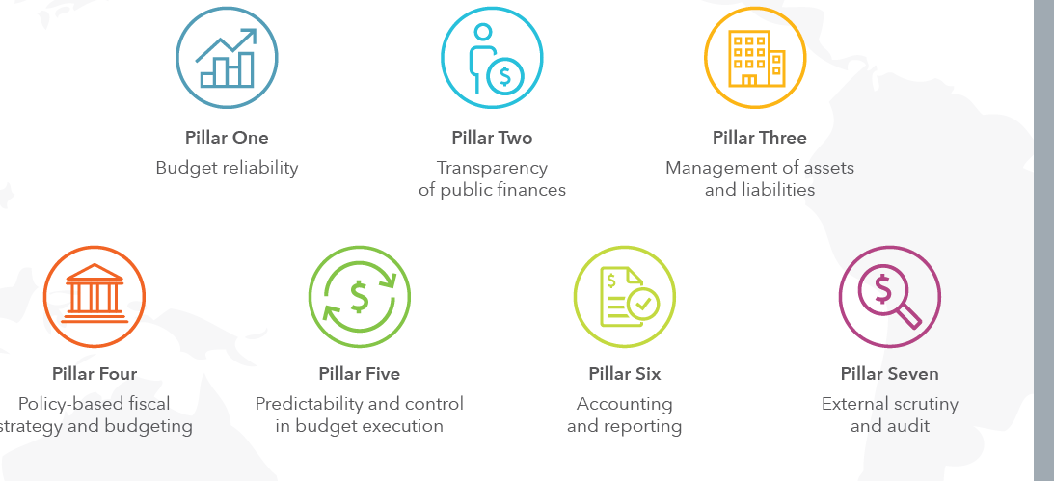
The Seven Pillars of the PEFA Framework – Figure 2

Slide 52
PEFA Country Assessments
PEFA assessments are done periodically, on a country by county basis.
CSO/Trade union researchers and advocates can make use of these country assessments for their own analyses, M&E studies and advocacy activities.

