Slide 1
Investing more and better in universal social protection
Global People’s Assembly, 22 September 2021
Valerie Schmitt, Deputy Director
ILO Social Protection Department, Geneva

Slide 2
Today I will make the following points:
Social protection is a human right and an economic necessity
Social protection is still not a reality for 53% of the world’s population
COVID-19 has been a wakeup call
What is universal social protection
Achieving universal social protection is possible
Investing more is necessary
Investing better based on the application of social security standards
ILC discussion in June 2021, and taking the high road to universal social protection

Slide 3
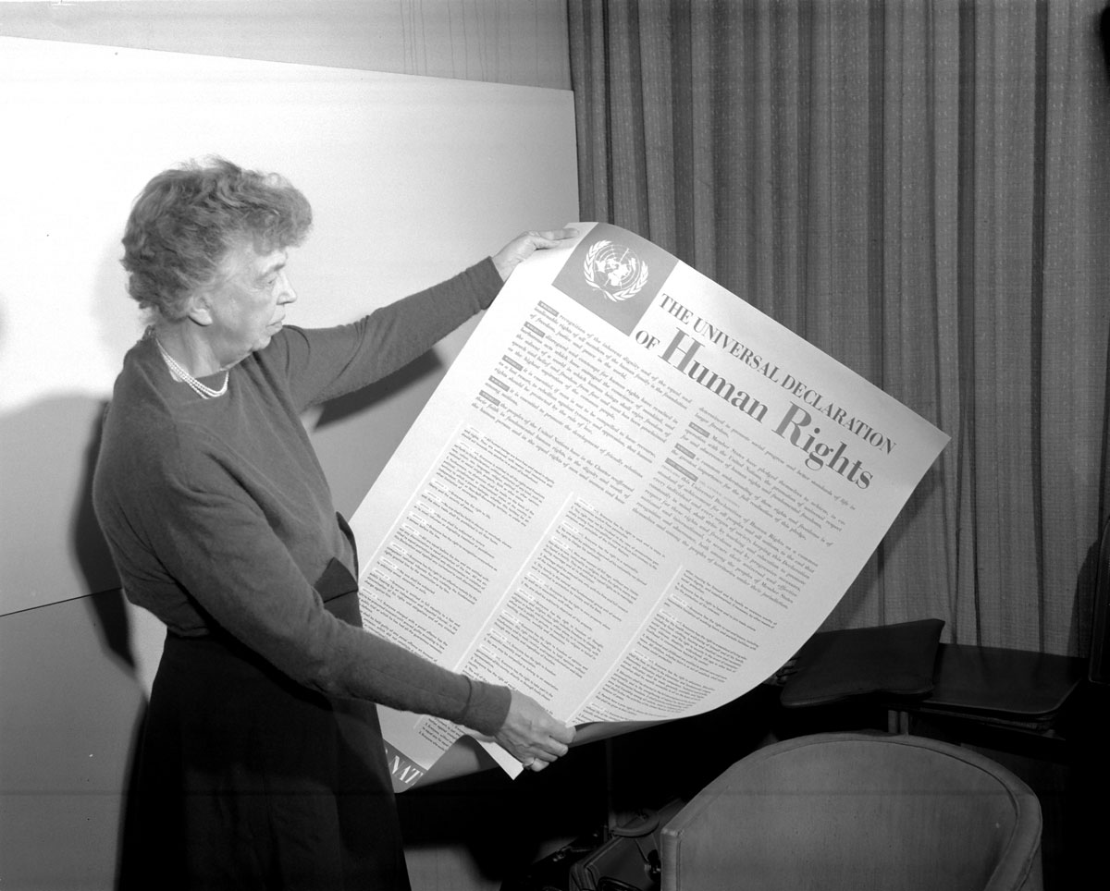
Social Protection is a human right
Article 22. Everyone, as a member of society, has the right to social security and is entitled to realization, through national effort and international co-operation and in accordance with the organization and resources of each State, of the economic, social and cultural rights indispensable for his dignity and the free development of his personality.
Article 25. (1) Everyone has the right to a standard of living adequate for the health and well-being of himself and of his family, including food, clothing, housing and medical care and necessary social services, and the right to security in the event of unemployment, sickness, disability, widowhood, old age or other lack of livelihood in circumstances beyond his control. (2) Motherhood and childhood are entitled to special care and assistance. (…)
The right to social security is also recognized in many national constitutions and laws
Notes:
The universal declaration of human rights recognizes the right to social securit in its article 22, as well as the responsibility of national effort and international cooperation to realize this right.
Article 25 is equally important as it mentions the importance of income security (adequate standard of living) and lists a number of risks or contingencies that will form the branches of social security systems such as unemployment, sickness, disability, old age.

Slide 4
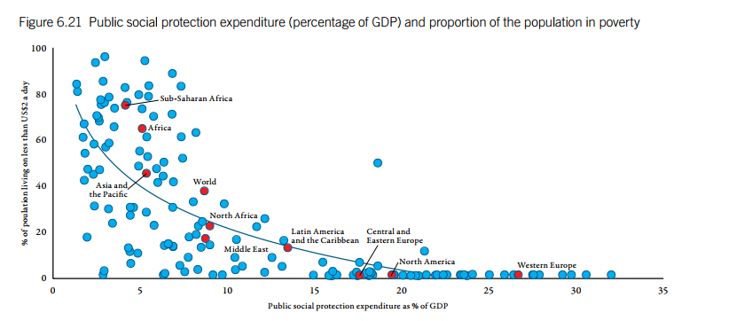
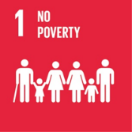
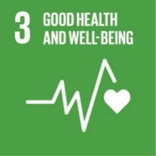
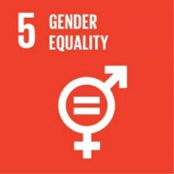
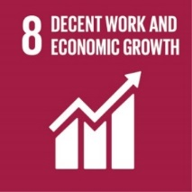
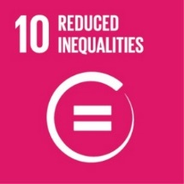
Social Protection is an economic necessity
This graph illustrates how higher levels of social protection expenditure are associated with lower levels of poverty.
It also contributes to other development objectives
This is one of reasons why it is a target of five sustainable development goals
Notes:
Social protection reduces poverty – this graph illustrates how higher levels of social protection expenditure are associated with lower levels of poverty.
Social protection transfers are a key tool used by governments to redistribute wealth and, as a result, can be very effective in tackling inequality. Well-designed social protection policies address not only income inequality, but also various other dimensions of inequality.
Social protection contributes to a number of other development objectives – it facilitates access to health care and education, if well designed it can contribute to gender equality, it contributes to just transition to greener economies, it supports enterprises and workers during crises and structural transformations of the economy, it is an enabler of the transition from the informal to the formal economy, it is a necessary building block for countries to be able to respond to natural disasters and epidemics. This is why it is a target of several SDGs.

Slide 5
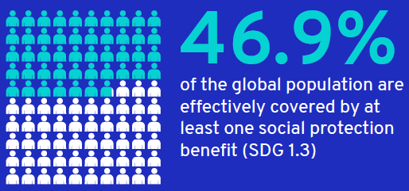
Social protection is still not a reality for 53.1% of the world’s population
Notes:
Regional differences – highest exclusion in Africa
The vast majority of children globally — 73.6% or 1.5 billion —— receive no social protection benefits.
Only 44.9% of pregnant and childbearing women receive a cash maternity benefit.
Just 33% of the working-age population is legally entitled to sickness benefits.
Only 35.4% have employment injury protection.
Fewer than one-in-five unemployed workers actually receive unemployment benefits.
Just 33.5% of people with severe disabilities receive a disability benefit.
The most widespread - and so one could say the most successful - form of social protection is the old-age pension. Worldwide, 77.5 per cent of persons above retirement age receive some form of old-age pension, yet benefit levels are often insufficient to meet their needs.
Only two-thirds of the global population are protected by any kind of health scheme; and some of these schemes have significant gaps that threaten people’s health and dignity.

Slide 6
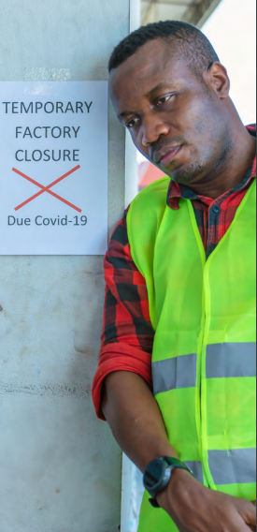
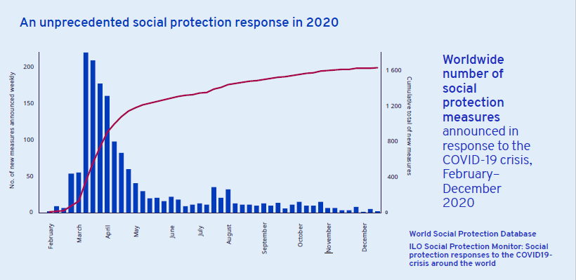
COVID-19 has been a wake-up call
Notes:
The COVID-19 pandemic has alerted the global community to the crucial importance of social protection. And it has put social protection high on governments’ agenda, and agencies’ response to the crisis. It was the largest ever mobilization of social protection measures, reaching out to those previously unprotected!
Faced with COVID 19, countries and the international community have mobilized to put in place emergency solutions to facilitate access to health care and provide income security to populations. According to ILO Social Protection Monitor, within a few months, nearly 1,600 social protection emergency measures have been adopted in 209 countries. Countries that already had robust social security systems were ahead of the game, as they only needed to adapt existing mechanisms.
This crisis has sent us at least two messages:
The widespread recognition of the necessity and value of social protection
The importance of building robust systems to meet today's social protection needs and to be better prepared to meet tomorrow's challenges.

Slide 7
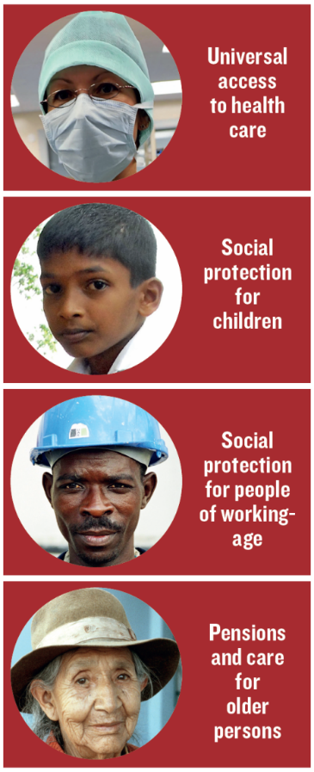
What is universal social protection?
ILO Member States have adopted the social protection floors Recommendation in 2012
All residents have access to essential health care, including maternity care
Social protection floors are the foundation of comprehensive social protection systems that ensure universal access to adequate protection in line with ILO social security standards
All children enjoy basic income security, providing access to nutrition, education, care, and any other necessary goods and services
Four basic guarantees
All persons in working age who cannot earn sufficient income, enjoy basic income security, particularly in cases of sickness, unemployment, maternity, disability
All older persons have basic income security

Slide 8
What is universal social protection?
ILO Member States have reaffirmed the necessity of achieving Universal Social Protection at the Recurrent discussion on social security in June 2021
Five adjectives:
Universal – leave no one behind – informal economy, rural workers, migrants, etc.
Comprehensive – accross life cycle, all risks/contingencies – health, child benefits, unemployment, maternity, disability, survivors, employment injury, old age…
Adequate – allow for a life in dignity
Sustainable – robust, well managed, financial sustainability
Adapted – to the changes in economies and societies and new risks (ageing, climate)

Slide 9
Achieving universal social protection is possible
Argentina (children, maternity)
Bolivia (old age)
Cabo verde (old age)
China (health, pensions)
Colombia (health)
Eswatini (old age)
Mongolia (children)
Rwanda (health)
South Africa (old age, disability, public works)
Thailand (health, pensions)
Timor Leste (old age and disability)
Trinidad (old age pensions and care)
Notes:
Many countries have achieved USP for components of the social protection floor, for instance for health (Rwanda), children (Mongolia), maternity (Argentina), disability (South Africa), old age (Cabo verde, Eswatini)

Slide 10
Investing more is necessary (+3.8% of GDP)
Low-income countries would need to invest an additional USD 78 billion or 16 per cent of their GDP to close the annual financing gap in 2020
The financing gap in low and middle income countries represent 1.2 trillion USD or 3.8% of countries GDP on average
Sub saharian African countries invest today 5.6 per cent of their GDP on social protection. They should add 8.2 per cent, to close the fianncing gap, or multiply by 2.5 their current investment.
 | Total gap (billions of US$) | Total gap (percentage of GDP)
All low- and middle-income countries | 1,191.6 | 3.8
Low-income countries | 77.9 | 15.9
Lower-middle-income countries | 362.9 | 5.1
Upper-middle-income countries | 750.8 | 3.1
Sub-Saharan Africa | 136.9 | 8.2

Slide 11
Investing more is necessary – available options
Expanding social security contributions (compliance, extension to informal economy)
Increasing tax revenues
Eliminating illicit financial flows
Reallocation of public spending
Using fiscal and central bank foreign exchange reserves
Managing debt: borrowing or restructuring sovereign debt (ex: debt swap)
More accommodating macroeconomic framework
International solidarity: increasing ODA & innovative financing (SDR, GAFA taxes, billionaires tax…)
Notes:
Hence, if we want to achieve human rights to social protection and health by 2030, we need to invest more in social protection.
These additional investments should come primarily from national sources.
Countries have shown that there are many ways to increase domestic resource mobilization, through reallocation of public spending (such as from fuel subsidies to social protection), the creation of new earmarked taxes (such as on natural resources), new income taxes or the extension of contributory social protection to workers in the informal economy.
One promising path is the extension of contributory social protection to workers in the informal economy, which would reduce the need for social assistance, while increasing the contribution and tax base in the country, and formalizing the economy. For instance, for the Novissi programme in Togo that I mentioned at the beginning, discussions are underway on how to build on this measure and incentivise informal workers to join the contributory social insurance scheme.
Many more options exist but have not yet been fully explored.
Nonetheless, for the low-income countries, where the social protection financing gap is extremely high compared to their limited fiscal capacity, domestic resource mobilization will not be enough.
These countries should be able to seek international support, at least for a temporary period.
This should not be mere “helicopter money” but should be used to support national counterparts in mobilizing domestic resources for social protection, and sustainable social protection systems.

Slide 12
It is equaly important to invest better
Primary responsibility of the State
National consensus based on effective tripartite social dialogue
No one is left behind to realize the right to social security
Making progressive and sustainable investments
Ensuring social solidarity, including solidarity in financing
Exploring diverse approaches and mechanisms
Ensuring good governance and creating synergies (with other policies, across institutions)
Notes:
Investing better means that social protection reflects a national consensus -- It is of course the primary responsibility of states to set up national social protection systems. However, these should not be built unilaterally, rather through social dialogue between government, trade unions and employers’ organizations, with consultations with civil society organizations. Tripartite dialogue not only allows the views and interests of the different parties to be taken into account, but also enables to reach a national consensus on social protection policies and reforms, which is a guarantee of social peace. Such involvement also increases national ownership, compliance and accountability, which are necessary for achieving universal coverage and financial sustainability.
One of the fundamental reasons for social protection is redistribution, between rich and poor, healthy and sick, male and female, active and inactive. Social protection systems are based on mutual aid and social solidarity, they are not mere individual savings accounts that do not share the risks nor redistribute income. Investing better means choosing policy options that allow for such redistribution and solidarity.
To protect people, social protection systems not only need to be well designed, but also well managed. This is why the standards also offer advice on good administrative and financial management of schemes, so that social protection systems can be and remain sustainable. First, transparent, accountable and sound financial management and administration ensure that social protection objectives are achieved in the most cost-effective and efficient way. Transparency is also key to facilitating affiliation and access to benefits and enhancing trust in the system. Second, regular monitoring of implementation and periodic evaluation are needed to determine the extent to which strategies to extend social protection have been successful, are on track, and where policy adjustments are necessary to reflect changing realities or ensure the achievement of protective outcomes.

Slide 13
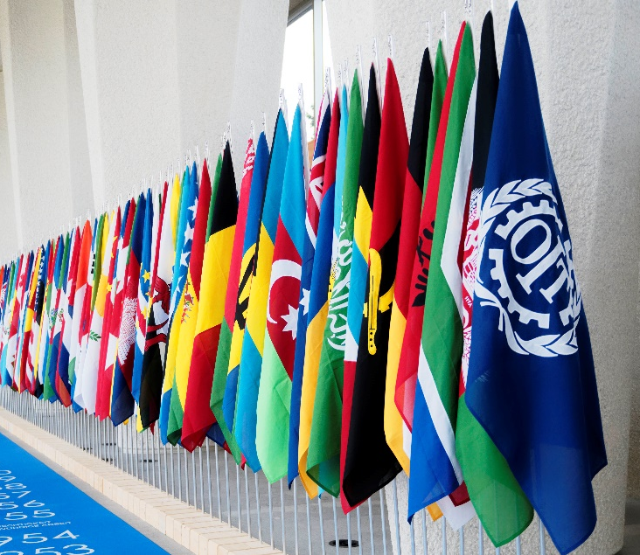
ILC 2021: Universal social protection and robust systems
Promote & support universal social protection (5 adjectives: universal, comprehensive, adequate, robust/adapted, sustainable)
Alignment with ILO SS Standards + ratification campaign
Coherence with other policies (formalization, green/climate change, employment, migration …)
ILO Flagship Programme to provide technical assistance and build capacities and knowledge
Partnership with the UN, IFIs in policy making and financing
Explore a Global Financing Mechanism for social protection
Global call to action for a human-centred recovery from the COVID-19 crisis
Resolution and conclusions on social protection (social security)

Slide 14
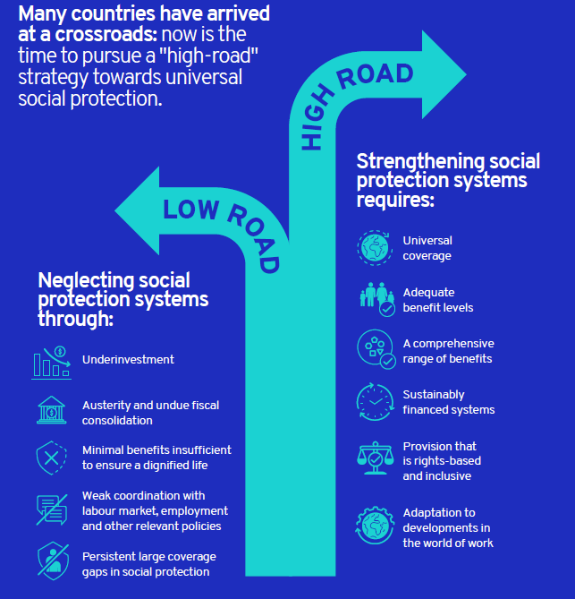
Taking the «high road» to USP
Social protection has played a key role in the COVID-19 policy response as stabilizer to protect people’s health, jobs and incomes
Unique policy window for making the right choices regarding the future of their social protection systems; countries are at the crossroads
high-road strategy of investments in universal social protection systems
low-road approach of minimalist social protection policies and fiscal consolidation
You can take the high road!
Notes:
Countries are at a crossroads with regard to the trajectory of their social protection systems
Countries can use the policy window prised open by the pandemic and build on their crisis-response measures to strengthen their social protection systems and progressively close protection gaps, in particular for workers in the informal economy, thereby ensuring social protection for workers in all types of employment and facilitating transitions to the formal economy.
Such a high-road approach will ensure that everyone is protected against both systemic shocks and ordinary life-cycle risks. Adequate social protection is critical not only for workers, but also for employers, as COVID-19 has demonstrated, as a key stabilizing factor for societies and economies.
The alternative would be to acquiesce in a ‘’low-road’’ approach that fails to invest in social protection, thereby perpetuating large protection gaps and providing minimal provision insufficient to ensure a dignified life. This traps countries in a “low cost–low human development” trajectory that represents a lost opportunity for reconfiguring societies for a better future.

Slide 15
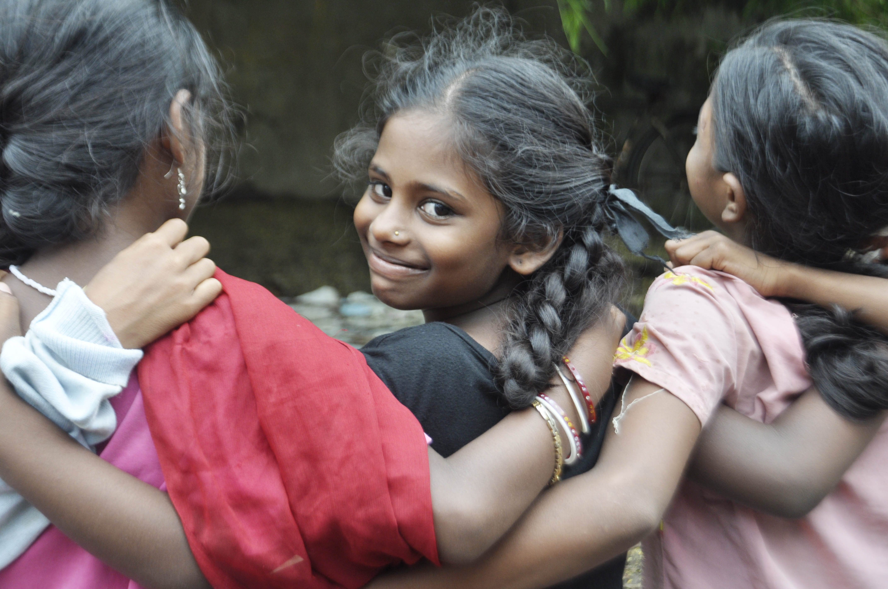
Thank you!!

