Slide 1
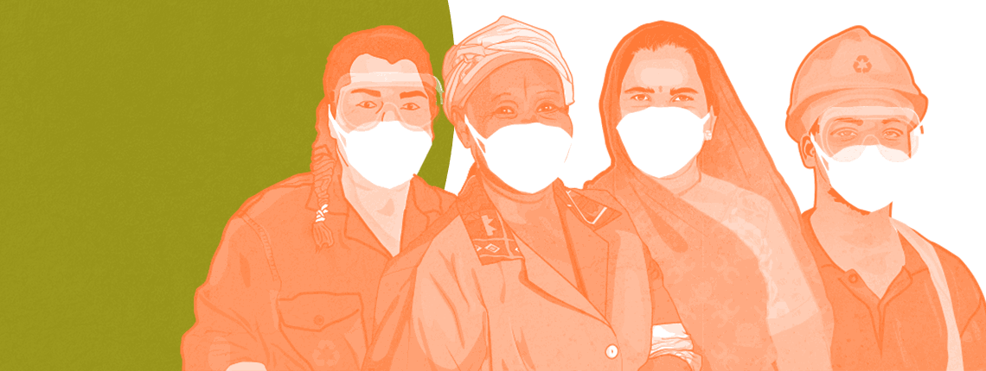
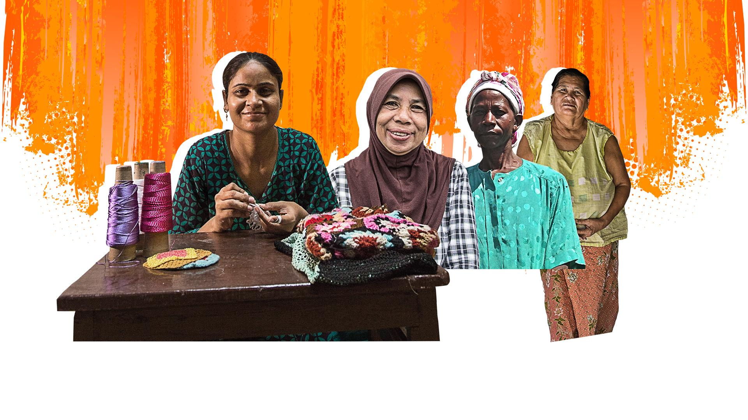
SOCIAL PROTECTION FOR INFORMAL WORKERS
Decade of Action to achieve Universal Social Protection by 2030
22 September 2021

Slide 2
Notes:
For home workers like Chevonne who rely on sewing orders from subcontractors to survive, the COVID19 crisis brought a sudden halt to orders.
With no relief from the government, she had to find ways to survive.

Slide 3
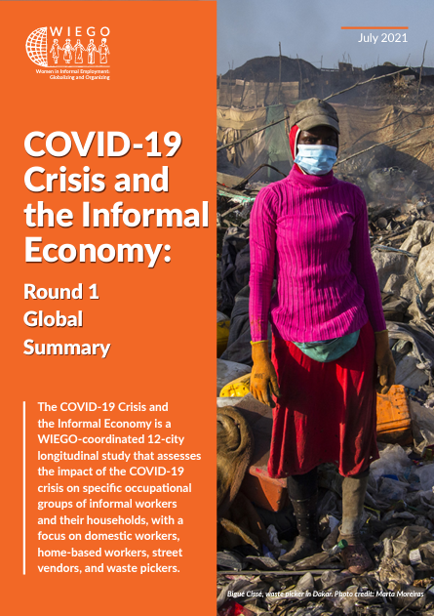
Notes:
Informal employment accounts for over 60 per cent of all global employment, representing roughly two billion workers, and 90 per cent of employment in developing countries (ILO 2018). WIEGO conducted a longitudinal study that assess the impact of the COVID-19 on specific occupational groups of informal workers and their households, with a focus on domestic workers, home-based workers and street vendors, and waste pickers.
I will be sharing key findings from the said study with focus on older informal workers

Slide 4
Key Findings
The impact on earnings among informal workers was as dire as projected by the ILO and other observers.
Occupational sector and differentiated characteristics within these sectors strongly influenced how the COVID-19 crisis impacted workers.
Results confirm a disproportionate impact on women workers’ livelihoods.
Increased reliance on asset-depleting coping mechanisms and household responsibilities have put considerable economic and emotional strain on the households of the working poor.
In the absence of sufficient local government support, informal workers took their own health and safety initiatives and invested in protective protocols.
Government relief efforts were an important source of support where they reached workers, but were limited and uneven in reach, and frequently undermined by local anti-worker policies.
MBOs (Membership-Based Organizations) played a crucial role in providing support to workers to mitigate the economic, physical and mental health impacts of COVID-19.
Notes:
The impact on earnings among informal workers was as dire as projected by the ILO and other observers. Average earnings in April were only 21 per cent of preCOVID earnings, and 75 per cent of respondents reported zero earnings. By mid-2020, when most severe restrictions had been lifted, average earnings were still only 55 per cent of pre-COVID earnings.
Occupational sector and differentiated characteristics within these sectors strongly influenced how the COVID-19 crisis impacted workers. (e.g Among domestic workers, “live-out” workers were more likely to face unemployment, while “live-in” workers suffered deteriorating working conditions and terms of employment.)
Results confirm a disproportionate impact on women workers’ livelihoods. (For example, Earning losses in April and mid-year were greater for women than for men, regardless of the sector of employment)
Increased reliance on asset-depleting coping mechanisms and household responsibilities have put considerable economic and emotional strain on the households of the working poor. (e.g 54% of women reported increased direct and indirect care)
In the absence of sufficient local government support, informal workers took their own health and safety initiatives and invested in protective protocols. (e.g vast majority of informal workers used Personal Protective Equipment (PPE), predominately at their own expense and in spite of heavily constrained resources)
Government relief efforts were an important source of support where they reached workers, but were limited and uneven in reach, and frequently undermined by local anti-worker policies. ( overall, 41 per cent of workers reported receiving a government cash relief grant and 42 per cent reported receipt of government-provided food aid. )
MBOs (Membership-Based Organizations) played a crucial role in providing support to workers to mitigate the economic, physical and mental health impacts of COVID-19. (From facilitating negotiations with government agencies and local municipalities to supporting workers’ registration for relief measures, worker organizations rapidly mobilized much needed resources and reliable information for informal workers.)

Slide 5
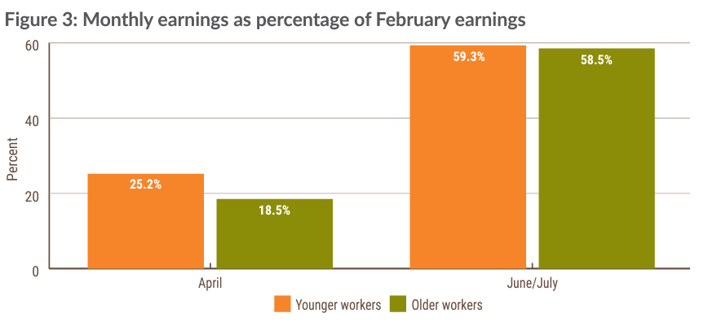
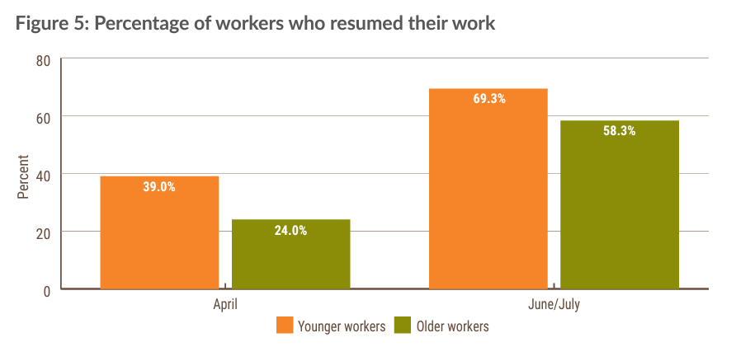
Older Informal Workers and COVID-19
The earnings of older informal workers fell to a greater extent than those of their younger counterparts, and income recovery has been slower
Older people living in countries with social pensions in place were often able to receive timely income support during the crises.
Notes:
The pandemic has put a spotlight on the older persons, who are the most vulnerable to the virus. Older adults are more likely to get very sick from COVID-19, but at the same time, 3 out of 4 older persons are in informal employment globally.
Even before the pandemic, older informal workers are particularly vulnerable to poverty, poor health and decent work deficit. Many informal workers, particularly women, have no option but to continue working in old age in order to survive, despite ill-health suffered by many because they have no pension. Less than 20 per cent of people aged 60 and older in most low-income countries have income security through a pension, and women are less likely than men to have a pension.
When COVID-19 hit, the earnings of older informal workers fell to a greater extent than those of their younger counterparts, and income recovery has been slower . There is a strong likelihood thatolder workers reduced their working days more than younger workers because of age-specific movement restrictions, older people’s heightened vulnerability to the virus or a decline in work opportunities for older workers as a result of COVID-19. Further analysis from the survey showed that informal workers who continued to work had low access to personal protective equipment, often having to finance this themselves,
On the positive side, we also found out that older people living in countries with social pensions in place were often able to receive timely income support during the crises.

Slide 6
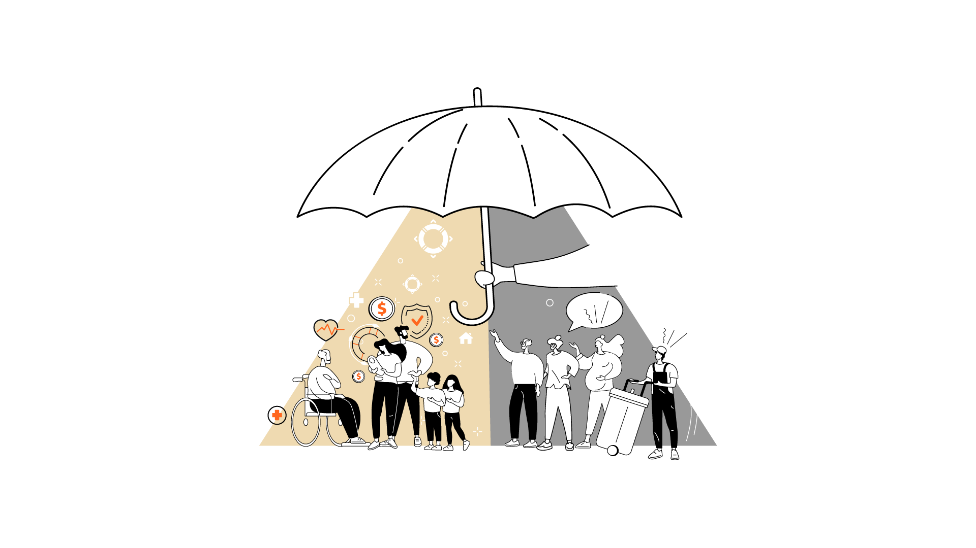
LIMITED SOCIAL PROTECTION
Illustrations: © AdobeStock
Notes:
Even prior the pandemic, informal workers have limited social protection.

Slide 7
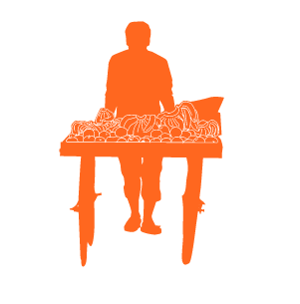
MISSING MIDDLE
100%
Upper Middle Class,
upper income and “rich”
SOCIAL INSURANCE
90%
Middle Class
80%
70%
MISSING
MIDDLE
Lower Middle Income
60%
50%
40%
Low Income (but not poor)
30%
20%
SOCIAL ASSISTANCE
10%
Poor
0%
Notes:
Social protection systems usually provides limited protection to informal workers. Social assistance that are targeted to the poor (such as means-targeted cash transfer programs), excludes - by design – a large proportion of people who do not qualify as extremely poor but vulnerable to poverty, such as the informal workers. It provides limited protection for low income informal workers whose incomes may be just enough to make ends meet, but may be vulnerable to shocks that can push them in to poverty. On the other hand, contributory social security is out of reach to this group of people because of the low disposable income and informality of work. Put together, poverty-targeted social protection and contributory-based social security leave a “missing middle” in social protection programs.
Why are informal workers the missing middle?
They are not considered to be poor enough to benefit from cash transfers targeted at the extreme poor often in rural areas (i.e. safety net programs)
They are not eligible for cash transfers targeted at children and older persons
Their incomes are too low and irregular to contribute to social insurance schemes
They are legally excluded from social insurance schemes

Slide 8
Key Messages and Calls to Action from Workers in the Informal Economy
5. Governments must ensure those without access to digital technology do not get further excluded from social protection programmes as the digital welfare state expands.
6. Governments must ensure that social protection policies and labour protections work together to protect workers from poverty.
7. Financing for social insurance should be progressive, sustainable and based on the principles of social solidarity. This means more powerful economic actors who profit from the work of informal workers must contribute to the financing of social insurance measures.
Invest in policies to connect workers to social protection and health and child care. These investments are integral to economic recovery.
Universal social protection is the goal. It should include a mix of social assistance, inclusive social insurance, and public services.
Women informal workers need targeted policies and services to address their unpaid care work and support them to keep earning.
Recognize the critical role informal worker organizations have played in the COVID-19 relief effort and must play in recovery.
Notes:
The COVID-19 crisis has brought about rapid and unprecedented attempts to extend social assistance to informal workers. This is an important OPPORTUNITY to not only learn more about how to extend this form of social protection to informal workers, but also to establish a long-term bridge between social assistance and social insurance schemes towards the building of comprehensive social protection systems. These arre the seven call to action from workers in the Informal Economy.
I would like to highlight some.
Invest in policies to connect workers to social protection and health and child care. These investments are integral to economic recovery.
International financial institutions can support governments by ending practices that result in governments cutting vital public spending and reducing social insurance contributions by employers and businesses. They can also cancel the debt of low income countries so they can invest in social protection and public services to support their economic recovery.
Clamping down on tax avoidance and evasion alongside more progressive tax systems where high-income earners pay proportionally more income and corporate taxes than the working poor can guarantee greater income redistribution through tax-financed social assistance programs.
High income countries and international financial institutions can fund the Global Fund for Social Protection - a model that helps the lowest-income countries pay for their citizens to have a minimum level of income security throughout their lives.

Slide 9
Specific to Older Informal Workers
Guarantee income security for all older people by implementing universal, non-contributory social pensions.
Tackle decent work deficit in older age by ensuring that labour market policies include older workers and combat age discrimination in the world of work.
Notes:
First, guarantee income security for all older people by implementing universal, non-contributory social pensions. Why social pension? This will give a minimal survival benefit among older informal workers, and can help mitigate, withstand and recover from crises in the future. It may also provide them with more of a choice as to whether they continue working, and at what intensity.
Secondly, tackle decent work deficit in older age by ensuring that labour market policies include older workers and combat age discrimination in the world of work. This has strong relevance in improving the livelihoods of older people in terms of providing greater opportunities and enabling them to have the right to choose to work.

Slide 10
Notes:
Investments in social protection are integral to economic recovery. As national governments, global financial institutions, donors and corporations consider economic recovery from the COVID-19 pandemic, they must consider how to support the recovery of the 2 billion people around the world working in the informal economy.

