Slide 1
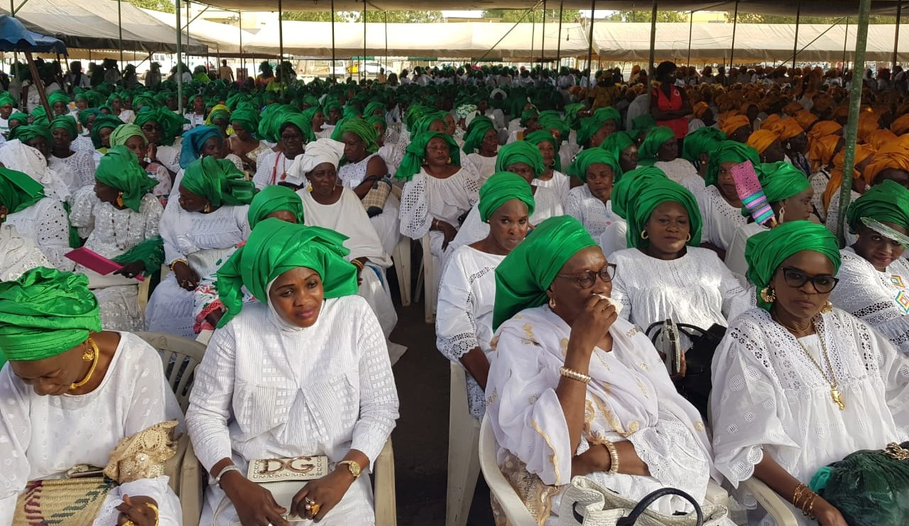
Improving synergies between SP and PFM
©Unicef
18 January 2024

Slide 2
SPPFM Project – Major Actions in 2023
Project extended by 4 months, closed in Sept 2023
Final reporting and financial settlement for FY 2023 and full project
Study – learning report
Final Evaluation of the project
2 global closing events, 1 organised & led by WCO
Regular project monitoring and oversight, including coordination with GCSPF

Slide 3
Improving synergies between SP and PFM: GCSPF ways of working
Advisory Board: experts from UNICEF, ILO, GCSPF
Nomination
Global Steering Committee:
EU, UNICEF, ILO, GCSPF, ...
GCSPF Core Team
Representation
Debriefing, consultation, approval
GCSPF Working Group of Coordinating Organisations (WCO)
Regular meetings (HQ / with countries) to ensure coherence, coordination...
WSM HelpAge Oxfam
Country Coordination
Exchange & Learning
Information & Guidance
WSM team SENEGAL
WSM team NEPAL
HA team UGANDA
Oxfam team CAMBODIA
Coordination, Support,
Cap. Strengthening
Coordination
Representation
National Network
National Network
National Network
National Network
National Steering Committee (NSC)
NSC
NSC
NSC

Slide 4
Major achievements
Overall
Strong national advocacy networks, improved coherence and stronger voice
Strengthened capacities of the civil society actors
Social Accountability and transparency initiatives
Improved SP programmes, their delivery and Govt’s commitment
Cambodia
Newly adopted Public Financial System Law leads to improved budget transparency
IEWs/Self-employed has been included in contributary SP scheme for Health
Eight policies and announcement related to SP
SP is included in the Pentagon strategy Phase 1 of the 7th Legislature assembly

Slide 5
Major achievements
Nepal
Two working guidelines covering the informal workers, self-employed and migrant workers in 2022,
Government declared the social security schemes for Migrant workers, Informal workers
Informal workers scheme (Medical care, health and maternity; accidental and disability protection; dependent family protection; and old age protection scheme)
Government drafted a national shock-responsive social protection/ cash policy (shock responsive social protection guideline)

Slide 6
Major achievements
Senegal
Budget reallocation from fuel subsidies to SP schemes for poor and informal workers, disabled and older people.
Payment of arrears of govt. subsidies to community mutual health organisations
Parliamentarian network for SP put in place
Commitment from local government institutions to support SP
Uganda
Capacity strengthening of network, government officials
Training of 40+ parliamentarians on SP-PFM
Increased financing of SP programmes including SAGE, SEGO, cash for work
Increased knowledge base on the SP policy even in hard to reach areas in parnership with Government

Slide 7
Learning Report – Recommendations
Based on the fact that: participation of CSOs in governance of sustainable development contributes to bridging representational gaps, garnering societal support to policies and regulations, facilitating communication, addressing institutional governance deficiencies at the global level, and addressing implementation gaps in upscaling services delivery initiated by CSOs, to ensure no one is left behind:
it is recommended:
Development cooperation partners not to work in siloes or with the organisations supporting their traditional core groups, but to facilitate a coherent and coordinated approach among the most relevant CSOs and networks.
Establishment institutionalised mechanisms for dialogue between policymakers and civil society on social protection policy development, implementation, and sustainable financing is instrumental; no competition with SD
Governments, as representatives of the people should avoid the shrinking of civic spaces that is observed in some countries and regions.
members of the coalition to continue advocating for domestic and international resource mobilisation to strengthen inclusive, effective, and sustainable networks.

Slide 8
Learning Report – Recommendations
Potential replication of the innovative approaches, strategies and tools that have been developed with this programme in other contexts, with necessary adaptation to the specific national contexts.
The GCSPF should consider engaging in international lobbying and advocacy efforts to secure the renewal of such a global programme.
Civil society and trade union coalition members should be encouraged to expand or intensify the training programmes developed during this programme to benefit their current and new members.

Slide 9
Closing workshop – Key findings and recommendations
Improved cooperation between CSOS s& Trade Unions (TUs) and to strengthen dialogue and consolidation of national advocacy networks.
Generation of knowledge and action on PFM for social protection, and on financing social protection more broadly
Awareness raising on public budget and on public expenditures
Generation of knowledge and have influence on social accountability mechanisms in social protection
Recommendations
Strengthen capacity on SP financing: CSOs: analytical capacity (CSOs, south-south coop, watchdog), Gvt and donors: transparency in data with emphasis on women, PWD, IE and adaptative SP
Strengthen social accountability mechanisms: Donors: in the design of all SP programmes, digitalisation, accessible info system, CSOs: documentation and sharing accountability approaches
Sustainability of networks: CSO and TU - strategic planning for resources mobilisation, synergies with other WG on SP, CGSPF- dissemination and use of materials created in the four countries? IO- mobilisation of funding for low- and middle-income countries.

Slide 10
Q&A
Thank you!

