Slide 1

The Global Accelerator on Jobs and Social Protection for Just Transitions
Valerie Schmitt, Deputy Director, Social Protection Department of the ILO & Coordinator of the Global Accelerator on Jobs and Social Protection for Just Transitions
Presentation on 25 April 2024, Global Coalition for Social Protection Floors
unglobalaccelerator.org

Slide 2

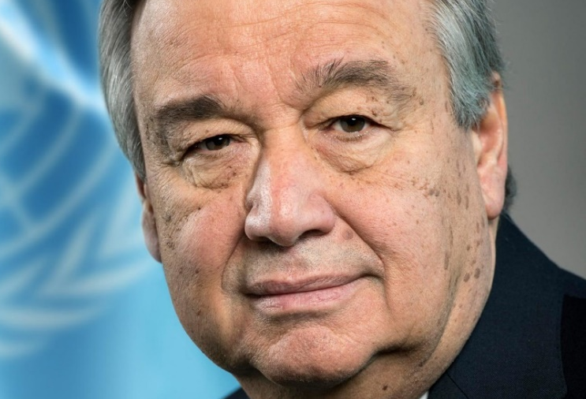

A UN initiative coordinated by the ILO
Vision & ambition
      From the COVID 19 crisis response to one of the 6 UN transitions to accelerate the SDGs
      Launched in 2021 to support countries in overcoming the COVID 19 crisis; is today one of the 6 UN transitions to accelerate the SDGs
      It promotes "social investments" (in USP, decent employment, formalization) at the heart of economic development to 1) overcome poverty, inequality, informality; 2) to facilitate demographic, economic and ecological transitions (make them just for the people)
      Endorsement by G20, G7, EU conclusions on triple transition
      High level commitment from 16 pathfinder countries
      A technical support facility provides support to 16 UNRCs/UNCTs
      20+ Public Development Banks part of the GA through a FICS working group
      UN-World Bank collaboration through “M-GA” partnership
      20 million Euros mobilized for UN through UN Joint SDG Fund
António Guterres, UNSG has launched the Global Accelerator in Sept 2021
Today it is one of the 6 UN transitions (energy, climate, education, agrifood systems, digital)
2
Notes:
Initiative launched by the UNSG in Sept. 2021. It brings together Member States, UN agencies, IFIs, public development banks, social partners, civil society, and the private sector
It promotes investments in decent jobs and social protection for:
1- Inclusive recovery from COVID-19 & other crises
2- JUST ecological, economic and demographic transitions
Expected return on investment (GDP growth, fiscal space increase, social dividend) & drive to SDGs

Slide 3



Three pillars of action
ENHANCED MULTILATERAL
COOPERATION
High-ambition coalition
of ministers
Policy coherence and common roadmap
Coordinated and coherent technical/financial support
Multilateral forum
& social summit
❶
INTEGRATED NATIONAL STRATEGIES
AND POLICIES
INTEGRATED FINANCING (DOMESTIC & INTERNATIONAL)
❷
International Labour Standards
▪
Integrated strategies
& policies (jobs,
universal social protection,
just transition)
Assessment of policy
and financing needs
through national
dialogue
Financing options
discussed through INFFs
SDG reporting
Domestic resources mobilization
Complementary international financial support
Enabling environment conducive to domestic investments
Return on investment
System-wide
Technical Support Facility
Need for a H-L commitment, to bring along several ministries, link policy and financing, mobilize international technical/financial support, and identify key entry points where transitions need to be “just”
Technical support
Capacity building
Data collection, knowledge
Results monitoring
Align international financial and technical assistance
Notes:
The Global Accelerator operates through three complementary and mutually supportive pillars:
Overcoming decent jobs and social protection deficits, by increasing domestic and international public and private investments in social protection and employment (through the integrated financing pillar of the Global Accelerator) and supporting the design, implementation and expansion of national social protection and employment policies and institutions.
Supporting poverty reduction and the formalisation of employment and enterprises as well as key transformations (structural, demographic and climate change) through integrated policy approaches linking social protection, skills, employment, and other policies (through the integrated national strategies and policies pillar of the Global Accelerator) while achieving better results for people, including women and youth, and leaving no one behind.
Enabling governments, social partners, UN, IFIs and donors to join forces at country, regional and global levels (through the enhanced multilateral cooperation pillar of the Global Accelerator) and building evidence on the GA’s contribution to achieving the social SDGs.

Slide 4
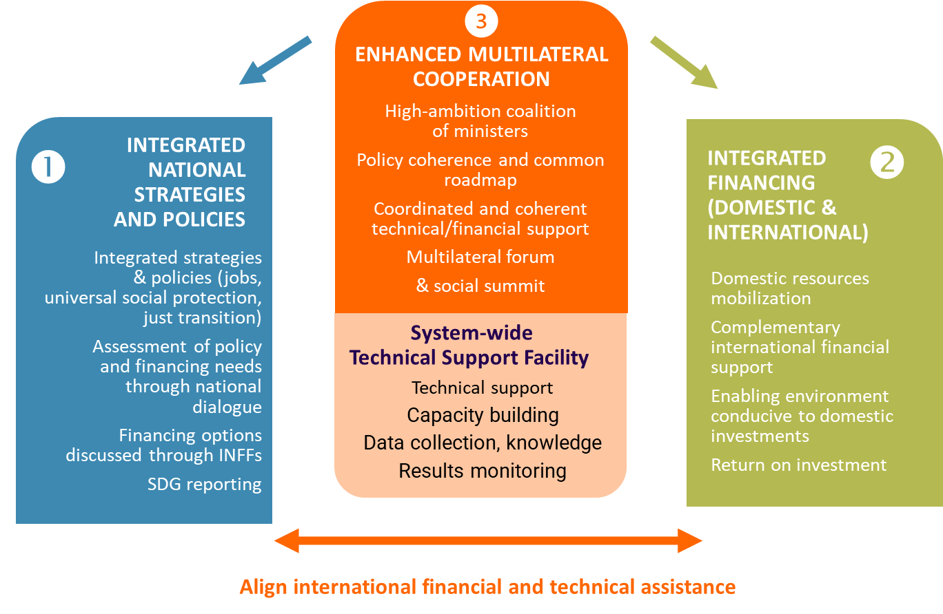
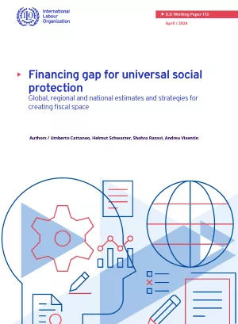
Financing gaps for social protection
      The three pillars of the GA contribute to reducing the financing gaps
      Integrated policy pillar: formalization of employment and enterprises, extension of social insurance, broadening the tax base
      Financing pillar: Min of Economy and Finance on board, WB-UN collaboration, PDB working group, linkages with existing funds (global shied, Loss and damage, GFATMs...), ODA/philanthropy, debt swaps, wealth tax?
      Multilateral cooperation pillar makes the first two possible
      Technical support facility: to support institution building, similar to the “facility branch” proposed by O de Schutter in the GFSPF design
In low- and middle-income countries, the financing gap to achieve USP equals 3.3 per cent of GDP annually or an additional US$1.4 trillion per year.
Notes:
https://www.ilo.org/publications/financing-gap-universal-social-protection-global-regional-and-national

Slide 5
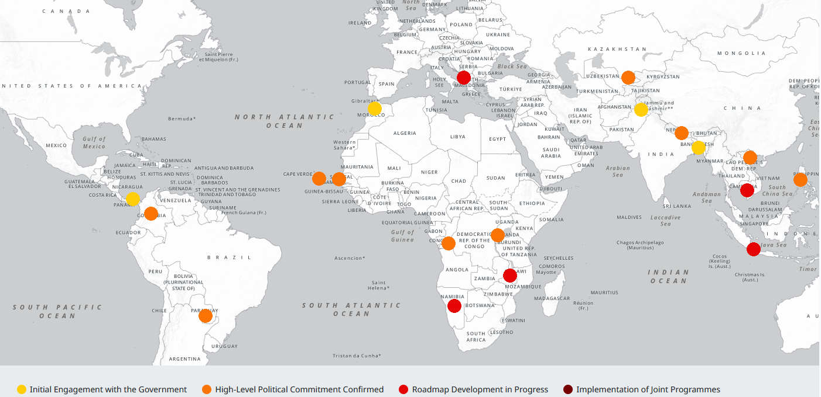
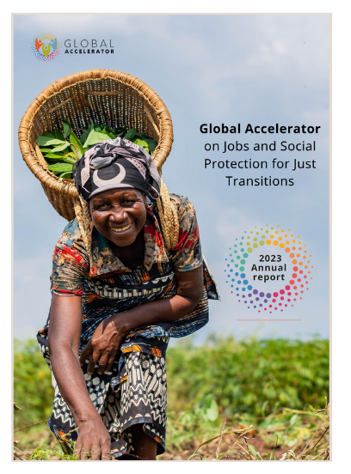
The GA on the ground
    Pathfinder countries dashboard https://www.unglobalaccelerator.org/pathfinder-countries
16 countries have shared high level commitments to join the GA
    10 early-stage pathfinder countries:
    Cabo Verde, Colombia, Democratic Republic of Congo, Kenya, Nepal, Paraguay, Philippines,
    Rwanda, Senegal, Viet Nam
    6 advanced-stage pathfinder countries:
    Albania, Cambodia, Indonesia, Malawi, Namibia, Uzbekistan
5

Slide 6
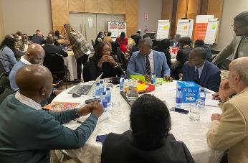
Draft entry points of national roadmaps
Uzbekistan
Entry points: Transition to formality, green transition, digital transition and digital inclusion
- Access to labour market for women and vulnerable groups, persons with disabilities
- Formalization in construction, transportation, agriculture, care economy
- Support to the newly created social protection agency & implementation of the new social insurance law
Albania
Entry points:
- Inclusion of persons with disabilities; Inclusive social protection system; care services/sector; private sector involvement in TVET; sustainable Financing
Senegal
Potential entry points:
- Extension of social protection; Skills and lifelong learning; Formalization; Decent job creation in priority sectors
- Sectors: Agriculture, craftsmanship, construction, infrastructure, electricity, water and sanitation, link with JET-P
Cambodia
Entry points: - TVET in tourism, construction, agrifood ; Extension of social protection, especially health and social assistance; Implement the formalization strategy (involvement of private sector, support to entrepreneurship, graduation); digitalization & formalization; financing gaps for SP extension
Rwanda
Entry points:
- Formalizing and digitalizing the urban economy
- Modernizing and greening agriculture + food security
- Achieving gender equality through investment in the care economy
Indonesia
Entry points: - Skill development and LLL to respond to private sector needs; Social protection and labour market policies for just transition; How to expand existing social protection schemes to IE workers; Financing gaps
- Sectors: Energy transition (away from coal) & link with UI; Removal of fuel subsidies and financing pensions; Rural access to energy and Adaptive Social Protection
* Sectoral entry points include: Agrifood systems, tourism, energy, digitalization of urban economy…
Namibia
Entry points:
- Employment creation; Youth employment and entrepreneurship; Expand social protection coverage; National formalization strategy
- Sectors: Green energy, agriculture, mining, tourism
Malawi
Entry points:
- Agriculture productivity
- Industrializing the mining sector
- Growth in the Tourism Industry
Building a national SP system
6

Slide 7

 | Skills | Social Protection (Financing, social assistance) | Healthcare | Formalisation | Persons with Disabilities
Albania | X | X |  |  | X
Cambodia | X | X | X | X
Indonesia | X | X |  |  | X
Malawi |  | X
Namibia |  | X |  | X
Rwanda |  |  |  | X
Uzbekistan | X | X |  | X | X
Draft entry points of national roadmaps
 | Agri-food | Digital | Climate change, energy transition, disaster response/ preparedness | Mining | Tourism | Youth | Women
Albania |  |  |  |  |  | X | X
Cambodia |  |  |  |  |  | X
Indonesia |  |  | X
Malawi | X |  |  | X | X
Namibia |  |  |  |  |  | X
Rwanda | X | X |  |  |  |  | X
Uzbekistan |  | X | X |  |  |  | X
A great diversity based on national priorities
GLOBAL ACCELERATOR ON JOBS AND SOCIAL PROTECTION FOR JUST TRANSITIONS
7

Slide 8
A coherent narrative
and consolidated results and impact
National ownership and consensus building
Policy and institutional changes
Population
> Persistent challenges (jobs, social protection, informality)
> New threats (climate, demographic, economic transitions)
Integrated policies
Adequate and sustainable financing
Alignment
+
Improved financing
Institutions building
Impact on people
Building evidence
Baselines
Results framework
Narrative

Slide 9
The Whole of Government including Labour,
Economy & Finance Ministries
Participatory development of national roadmaps
MDBs, PDBs
UNRC (United Nations Resident Coordinator),
UNCT (United Nations Country Team)
Private sector
National
roadmaps
Coherent
and structured demand
Social partners, civil society
Development partners
CSOs: 1- hold governments accountable for their H-L commitment ; 2- ensure that the integrated policies and financing indeed reach those in need (and support this proactively)
Strategic investments
Sectors of the economy
with social & fiscal impact
Public social protection and
labour market institutions
GLOBAL ACCELERATOR ON JOBS AND SOCIAL PROTECTION FOR JUST TRANSITIONS
9

Slide 10

Country | Contact persons
Albania | Zhulieta Harasani, ILO Tirana Maria Jose Chamorro, ILO Budapest | harasani@ilo.org
Cabo Verde | Fernando Sousa Jr., ILO Praia | sousajr@ilo.org
Cambodia | Oktavianto Pasaribu, Deputy Director, ILO Bangkok Jie Yu Koh, ILO Bangkok Giulio Bordon, ILO Bangkok | pasaribu@ilo.org koh@ilo.org bordon@ilo.org
Colombia | Italo Cardona, Director, ILO Lima Teresa Torres, ILO Lima Diana Carolina Pava, ILO Lima | cardona@ilo.org torrest@ilo.org pavad@ilo.org
Democratic Republic of the Congo | Dramane Batchabi, ILO Dakar | batchabi@ilo.org
Indonesia | Ippei Tsuruga, ILO Jakarta Diego Rei, ILO Jakarta | tsuruga@ilo.org rei@ilo.org
Malawi | Patience Matandiko, ILO Lusaka | matandiko@ilo.org
Namibia | Adolphus Chinomwe, ILO Harare Andrew Allieu, ILO Pretoria | chinomwe@ilo.org allieu@ilo.org
Nepal | Andre Bongestabs, ILO Kathmandu Kripa Basnyat, ILO Kathmandu | bongestabsa@ilo.org basnyat@ilo.org
Paraguay | Gerhard Reinecke, ILO Santiago | reinecke@ilo.org
Philippines | Khalid Hassan, Director, ILO Manila Ma. Concepcion Sardaña, ILO Manila | khalid@ilo.org sardana@ilo.org
Rwanda | Aurélie Klein, ILO Dar es Salaam | klein@ilo.org
Senegal | Dramane Batchabi, ILO Dakar Moussa Dieng, ILO Dakar | batchabi@ilo.org dieng@ilo.org
Uzbekistan | Nilufarkhon Kamalova, ILO Moscow Rim Nour, ILO Geneva | kamalova@ilo.org nourr@ilo.org
Viet Nam | Ingrid Christensen, Director, ILO Hanoi André Gama, ILO Hanoi | christensen@ilo.org dasilvagama@ilo.org
Contact persons at technical level for engagement in countries
Do not hesitate to contact focal points in case you/your members wish to be involved in national dialogues on the GA
GLOBAL ACCELERATOR ON JOBS AND SOCIAL PROTECTION FOR JUST TRANSITIONS
10

Slide 11
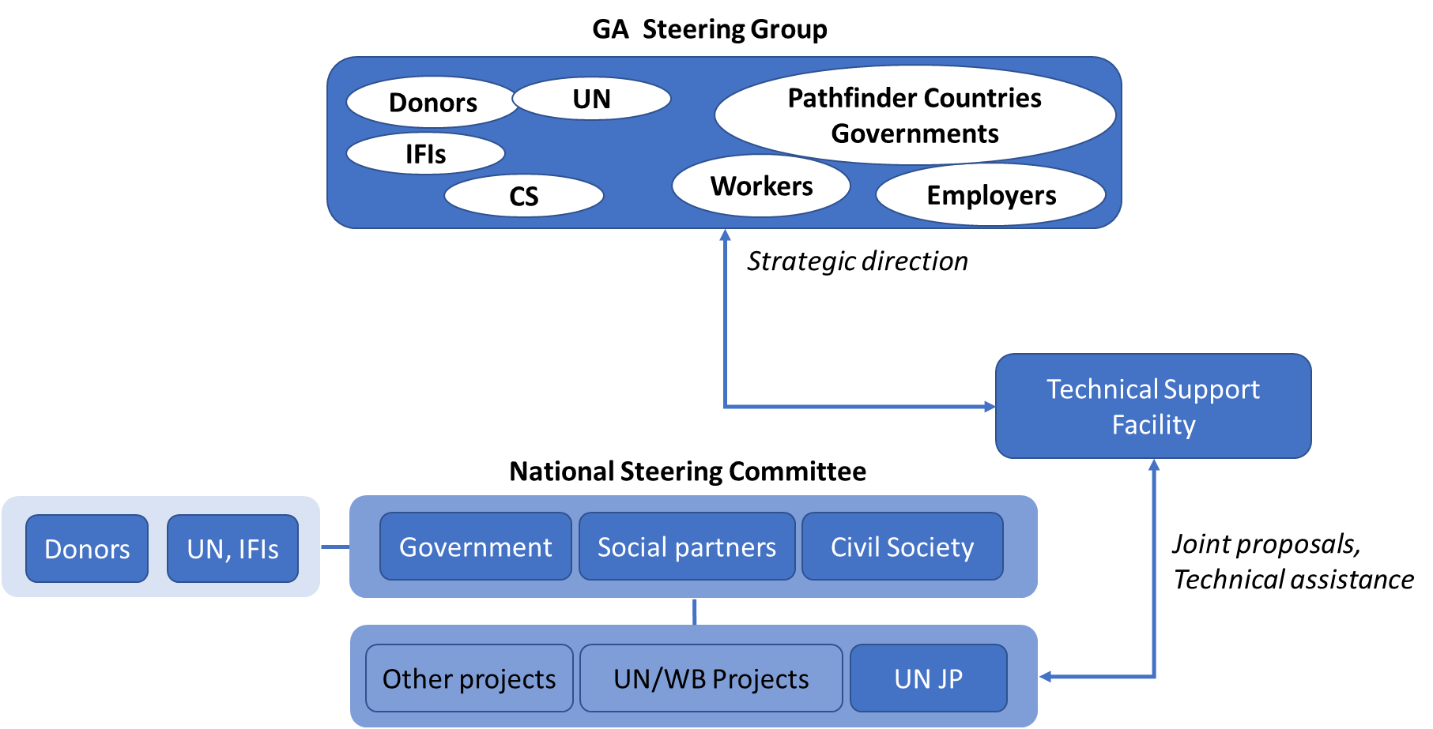
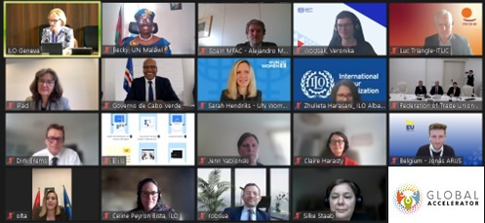
A democratic governance structure
The GA Steering Group
provides strategic guidance for the GA;
monitors progress made;
contributes to global knowledge sharing and dissemination of results and evidence;
plays a key role in advocacy and resource mobilization
GA Steering Group CSO Voting Members:
Laura Alfers (WIEGO, Markus Kaltenborn (GCSPF individual member)
Substitutes:
Séraphin Basore (INSP!R Rwanda), Nicola Wiebe (Bread for the World)
CSOs can have their say by participating in the governance of the GA; they can also participate technically in the Hub of experts and as independent reviewers of UNJPs.
GLOBAL ACCELERATOR ON JOBS AND SOCIAL PROTECTION FOR JUST TRANSITIONS
11

Slide 12

Next steps
      April – June 2024: Development of UN joint proposals to support GA design and implementation in 14 pathfinder countries
        Albania*, Cabo Verde, Cambodia*, Colombia, Indonesia*, Malawi*, Namibia*, Nepal, Paraguay, Philippines, Rwanda, Senegal, Uzbekistan*, Viet Nam (with * : advanced stage)
        UN collaboration ; UN/WB collaboration through dedicated “M-GA”
      May-June 2024: Independent review of UN joint proposals (possibility of CSOs to participate if they are member of USP2030)
      Mid-May 2024 and July 2024: GA Steering Group meetings to provide guidance, plus an additional meeting to discuss the common results framework and work under the financing pillar
      June-July 2024: Kick start implementation in early-stage pathfinder countries
https://www.unglobalaccelerator.org/

