Slide 1
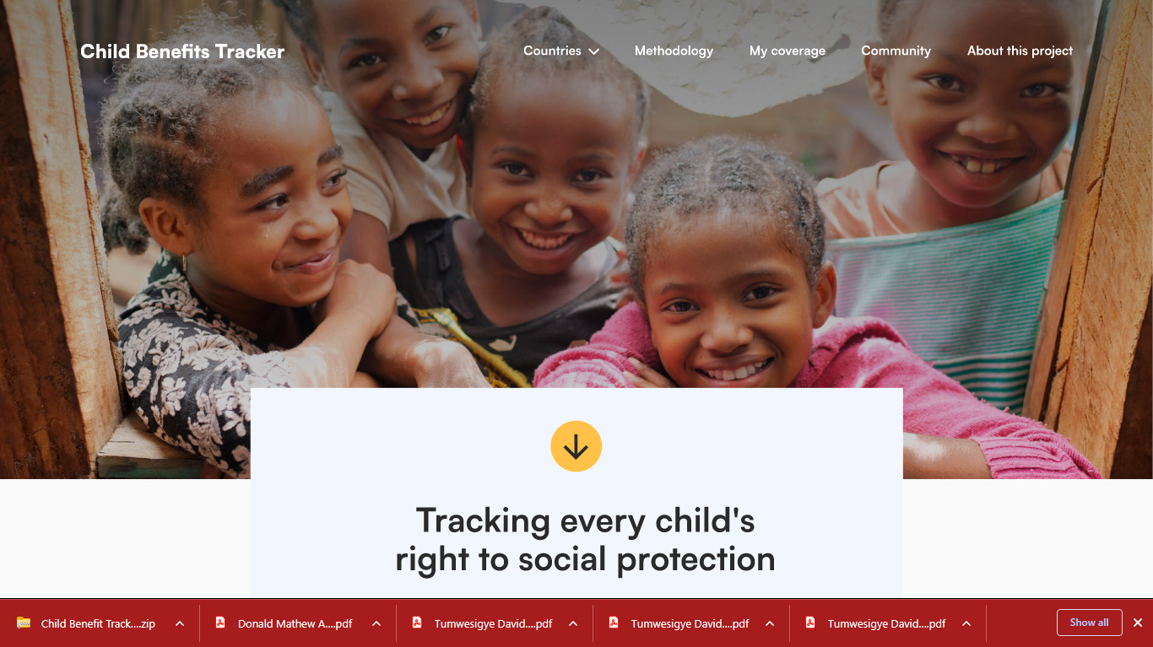
Notes:
2 Minutes
My name in David, I lead SC’s Global Policy and Advocacy on Child Poverty and lead our CoP on CSSP. I also co-chair the GCEP with UNICEF .
Thanks for the opportunity to present the Child Benefits Tracker. This tool is a product of an exciting partnership over the past 2 years between Save the Children, the ILO & UNICEF .
We developed this tool for tracking progress of children’s access to SP , to facilitate progressive policy dialogue and inspire more investment in CSSP.
We aim to ease the work of advocates and policy practitioners ( by bringing together all the global evidence in one place) so we can make a compelling case to governments and development partners to invest in CSSP with a gold to progressively realise universal child benefits .

Slide 2
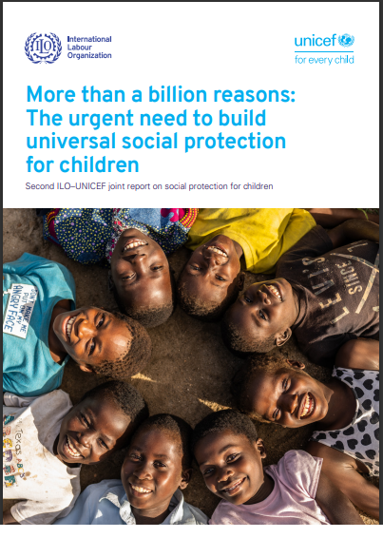
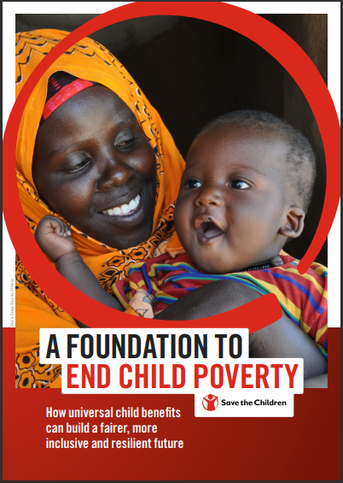

Notes:
In case you haven’t seen our flagship publication on UCBs, you will find the justification for UCBs. UCBs can form a great foundation for ending child poverty (which has been exacerbated by the climate crisis and inequality) and we share the same vision with ILO and UNICEF –hence the partnership

Slide 3
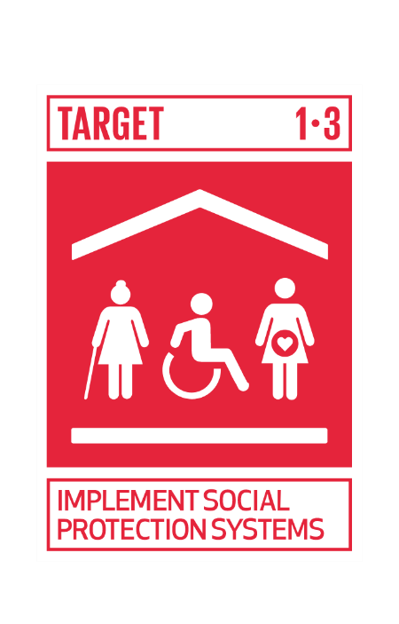


What challenge are we trying to solve?
Children have a right to basic income security (UNCRC Article 26).
UN Member states committed to ending extreme poverty, and halving poverty, including child poverty, by 2030 (SDG 1)
Social protection is a cost -effective tool for reducing poverty, supports families to invest in children, and can mitigate the impact of climate-related + other shocks
But public investment in social protection systems remains very low...
1 in 2 children
Less than 1 in 10 children
live in multi-dimensional poverty
in low-income countries access social protection benefits
Notes:
I minute
We know that Social protection is a basic human right and a proven tool to reduce poverty and enhance investments in children.
SP builds income security necessary for families to feed, provide care and access health and education services for their children.
It is a critical tool for building human capabilities and building inclusive societies; and will help us mitigate the impacts of the climate crisis.
Yet, public investment and coverage of SP –especially for children is very low.
We know: The world’s 2.4 billion children are bearing the brunt of the climate crisis – an emergency that is taking lives, eroding children’s rights and threatening their future
Yet, as you will see on the Child Benefit Tracker, public investment in SP –especially child benefits is very low.
Fewer than 1 in 10 children in low-income countries have access to child benefits, a figure which is 10 times lower than for those living in high-income countries
Without securing children’s access to social protection, we will fail to deliver on their fundamental human rights and the achievement of the Sustainable Development Goals.

Slide 4
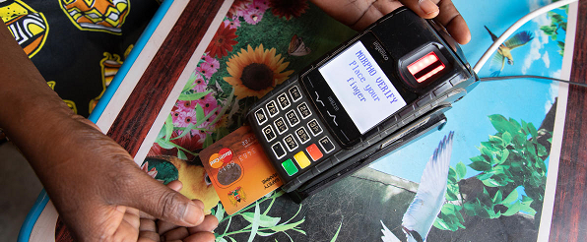
Cash & Social Protection – our focus for impact at scale
Cash is one of best evidenced ‘Anti-Poverty’ measures available – and an important part of humanitarian responses
Cash Plus (integrated) measures have best impact on child outcomes – and are our USP
Child Benefits part of the “Social Protection Floors” enshrined in SDG Target 1.3 and CRC
How cash helps achieve our Breakthroughs
Learn – Cash helps children stay in school – increasing enrolment and reducing drop-out including for adolescent girls
Survive – Cash plus nutrition has impact on levels of stunting in children. Cash can also increase take up of essential services such as vaccinations.
Be protected – cash can help reduce incidents of child marriage and can reduce incidents of intimate partner violence.
Goal 4: Safety Nets and Resilient Families
January 2022
Notes:
Reminder, why we promote UCB.

Slide 5
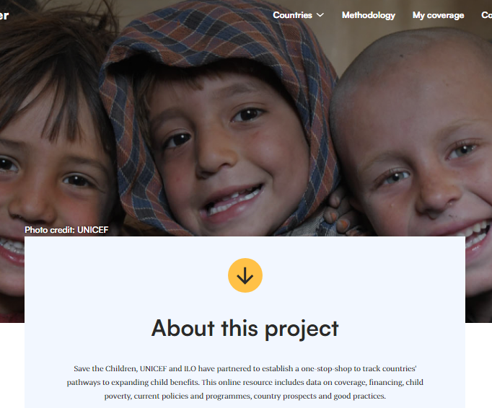
What are the benefits of a Global Child Benefits Tracker?
Notes:
Through the Child Benefits Tracker, we highlight the scale of global child poverty and examples of progress to inspire greater political will and investment in child-sensitive social protection systems”.
On the Tracker you will find the latest ILO data on Child Benefits including trend data on effective coverage in the country pages

Slide 6

What are the benefits of a Global Child Benefits Tracker?
A tool to support policy makers, academia, CSOs & campaigners to advocate to and with governments and development partners .
A platform to monitor progress towards SDG 1.3 and identify gaps in children’s access to social protection (focusing on child benefits) and ;
To facilitate:
  evidence based & progressive policy dialogue and advocacy for inclusive social protection
  mutual exchange of best practices and learning to inspire greater investment in child sensitive social protection
Notes:
1 minute
We want to ring the alarm with evidence and insights on what is possible and what actions need to be taken.
The platform will feature official statistics on child poverty and policies, legislation, coverage and financing on social protection for children and families at global, regional and country levels.
Data is from ILO, UNICEF, World Bank, Oxford Poverty and Human Development Initiative
The platform also includes a child-friendly page designed to support child campaigners
To promote greater engagement, it includes a dynamic community page on which we can feature highlights from key reports, expert commentary, practitioner insights in the form of best practices notes, expert blogs, infographics, country case studies, webinars, podcasts, video documentaries and an events calen
Refer to methodology page for more info on definitions and sources.

Slide 7
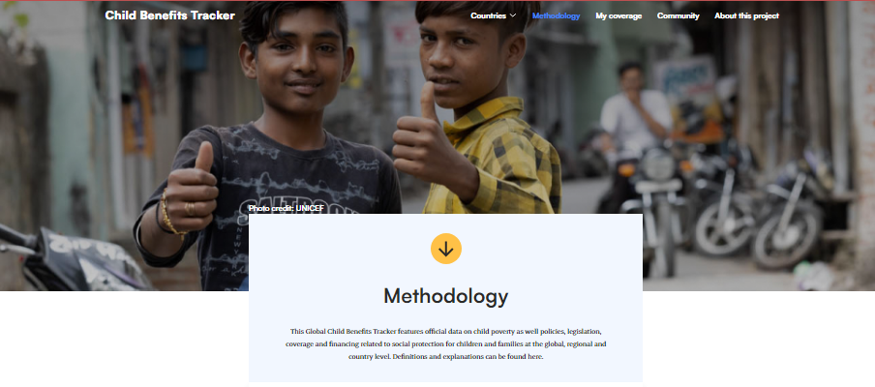
What is / of what use is a Global Child Benefits Tracker?
Notes:
Click to navigate the Tracker: 3 minutes
Compare HI and LICs coverage and poverty data on home page- 1m
Show Ethiopia country page and my coverage page 1m
Highlight methodology page for more info on definitions and sources-30 seconds
Show community page -30 sec

Slide 8




How can you contribute to the
Global Child Benefits Tracker?
https://www.childbenefitstracker.org
Notes:
Future plans and call to action : 1 https://www.childbenefitstracker.org/
Use and share the data on tracker,
confirm validity and novelty of data,
contribute- reports, blogs, podcasts, identify Thought Leaders,
Help Children to use it.

Slide 9





How can we help your advocacy and campaign effort with
Global Child Benefits Tracker?
https://www.childbenefitstracker.org
Notes:
Future plans and call to action : 1 https://www.childbenefitstracker.org/
We can support your events – mobilizing, hosting, partnership,
What shall we do?
Exercise:
Confirm that we have the latest and correct data.
Navigate to your country page and type in the chat box: What is the rate of SP coverage for children

Slide 10
THANK
YOU

