Slide 1

Financing gap for universal social protection
Global, regional and national estimates and strategies for creating fiscal space
ILO working paper by Umberto Cattaneo, Helmut Schwarzer, Shahra Razavi and Andrea Visentin
Presenter: Umberto Cattaneo
  Public Finance Economist
  Universal Social Protection Department
  International Labour Organization

Slide 2

Overview of the financing gap presentation
    Methodology
    Results
    Strategies to close the financing gap

Slide 3

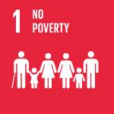


Methodology of the financing gap
Financing gap in social protection
Financing gap for the five social protection income guarantees
Financing gap in essential health care
The financing gap for the five social protection income guarantees refers to the monetary resources needed to provide a basic social security guarantee to those who are not currently receiving it
Data provided by WHO with methodology published in Stenberg et al. (2017)
Per capita cost of universal health care
Children
Persons with disabilities
Maternity
Older persons
The unemployed
Notes:
UMBERTO
Helmut has already provided context regarding the underlying motivation behind the revision of the financing gap under discussion. However, I would like to complement by saying that we did this revision because we wanted to base the financing gap estimations for the income guarantees on the effective social protection coverage calculated based on the Social Security Inquiry and corresponding to SDG indicator 1.3.1. In addition, we wanted to base the estimations for essential health care on the SDG 3.8 on Universal health coverage. Because this SDG target is considered as an overarching target that supports the achievement of other targets in SDG 3, which captures essential health care as framed in the ILO Social Protection Floors Recommendation.
As Shahra mentioned one other reason why the methodology has taken this structure is the necessity to produce country-level data and to limit the extent of imputations when information is not available. For this reason, the number of indicators involved in the determination of the financing gap is by construction limited to those where data availability is widest.
In this slide we have an overview of the conceptual framework the financing gap. Starting from the top right of the slide we have the country coverage. The estimations were carried out for 132 developing countries defined as those countries not belonging to the high-income category of the World Bank national income group classification. In addition, we also have information for 12 high-income G20 countries, as Shahra said these estimations were very much welcomed by the G20 Indian Presidency.
Let’s now turn to the core of the slide, the financing calculations can be split in two. On the left we have the financing gap in the 5 social protection areas, namely children, persons with disabilities, maternity, older persons and the unemployed. The financing gap in these 5 areas is calculated using the effective social protection coverage and corresponds to the monetary resources needed to provide a basic social security guarantee to those who are not currently receiving. Basically those who are not covered by any type of social protection.
Let’s now turn to the right side of the slide regarding the financing gap in essential health care. The financing gap in essential health care is the additional monetary resources needed to achieve a Universal Health Coverage Index, corresponding to SDG indicator 3.8.1 of 84 points. The 84 points of the Universal Health Coverage Index correspond to the population weighted average value of the Index observed in high-income countries.
But let’s see what the Universal Health Coverage Index is. It captures the coverage of essential health services, as per ILO Recommendation 202, and it is defined as the average coverage of essential services based on tracer interventions that include
Reproductive, maternal and newborn child health
Infectious diseases
Non-communicable diseases
And, service capacity and access, among the general and the most disadvantaged population.

Slide 4
Results
Financing gap % of GDP
Financing gap for achieving universal social protection coverage per year, as a percentage of GDP, by social protection benefit, by region and by national income group, 2024

Slide 5
Results
Financing gap % of GDP
Financing gap for achieving universal social protection coverage per year, as a percentage of GDP, by social protection benefit, by region and by national income group, 2024
% of GDP | Social protection (including health) | Essential health care | Five income guarantees (excluding health) | Children | Disability | Maternity | Old-age | Unemployment
Low- and middle-income | 3.3 | 2.0 | 1.3 | 0.6 | 0.2 | 0.05 | 0.3 | 0.2
Low income | 52.3 | 32.5 | 19.8 | 10.1 | 3.0 | 1.1 | 3.3 | 2.3
Lower middle income | 6.9 | 4.6 | 2.3 | 1.0 | 0.5 | 0.1 | 0.5 | 0.2
Upper middle income | 1.4 | 0.7 | 0.7 | 0.3 | 0.1 | 0.02 | 0.2 | 0.1
Africa | 17.6 | 11.4 | 6.2 | 3.2 | 1.1 | 0.3 | 0.9 | 0.7
Arab States | 11.4 | 6.9 | 4.5 | 1.7 | 0.4 | 0.3 | 1.2 | 0.9
Asia and the Pacific | 2.0 | 1.2 | 0.8 | 0.3 | 0.2 | 0.02 | 0.2 | 0.1
Europe and Central Asia | 1.9 | 1.2 | 0.6 | 0.3 | 0.1 | 0.02 | 0.1 | 0.2
Latin America and the Caribbean | 2.7 | 1.0 | 1.7 | 0.7 | 0.3 | 0.1 | 0.3 | 0.3

Slide 6
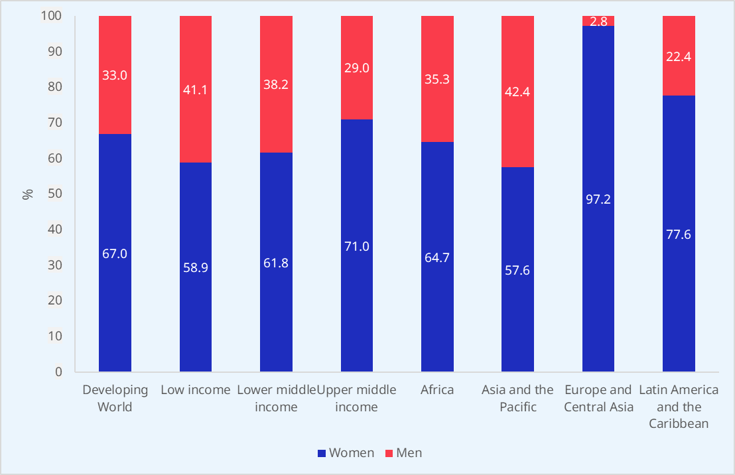
Results
Financing gap in old-age, distribution by sex
Women are currently bearing the brunt of the financing gap for old-age benefits
    Women spend a disproportionate amount of time doing unpaid care work at the expense of time spent in paid work, and are overrepresented in low-paid jobs, with poor working conditions, involuntary part-time arrangements, and limited prospects for career advancement.
    In the absence of other forms of pension coverage, non-contributory pensions, particularly in low- and lower-middle income countries, help bridge gendered coverage.
    Two-thirds of the financing gap to ensure universal coverage for old-age pensions would be allocated to paying benefits to women.

Slide 7
Results
Financing gap as % of government expenditure and social protection expenditure
Financing gap as a percentage of GDP, general government expenditure and social protection expenditure, by region and national income group, 2024
 | % of GDP | % of general government expenditure | % of social protection expenditure
Low- and middle-income | 3.3 | 10.6 | 31.6
Low-income | 52.3 | 310.0 | 2,737.3
Lower-middle-income | 6.9 | 26.9 | 120.7
Upper-middle-income | 1.4 | 4.3 | 11.9
Africa | 17.6 | 70.1 | 306.2
Arab States | 11.4 | 28.1 | 158.1
Asia and the Pacific | 2.0 | 6.6 | 22.4
Europe and Central Asia | 1.9 | 5.4 | 11.5
Latin America and the Caribbean | 2.7 | 7.7 | 18.0

Slide 8
Strategies to close the financing gap
Increase tax revenues
    Countries have a wide range of options to raise tax revenues, the most common in low- and middle-income countries are the rather regressive consumption/sales and value-added taxes (VAT).
    International competition to attract FDI has led many governments to reduce the respective tax rates and to otherwise increase tax concessions to corporations
    Governments face challenges in ensuring compliance with taxes at all levels, ranging from large corporations, MSMEs, own-account workers, to wage and salaried workers
    To promote tax compliance for small contributors, voluntary tax compliance programmes have been adopted in many countries (e.g. Argentina, Indonesia, Spain).
    Limited intergenerational social mobility has led to renewed interest in introducing wealth taxes to finance social protection programmes.

Slide 9
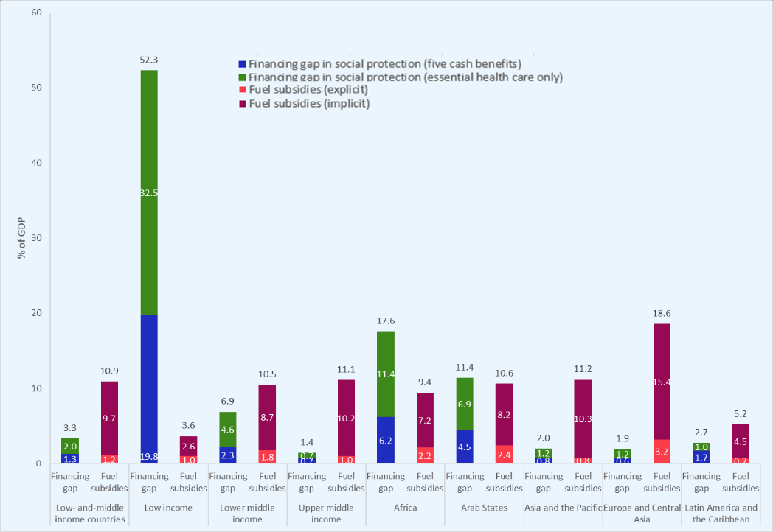
Strategies to close the financing gap
Revenues from explicit and implicit fossil fuel subsidies
    Evidence shows that at the domestic level, considerable fiscal space could be generated by removing explicit fuel subsidies as well as implicit fuel subsidies (i.e., introducing / increasing carbon pricing schemes in a way that charges for environmental costs of carbon)

Slide 10
Strategies to close the financing gap
Extending social security finance by increasing contributory revenues
Additional fiscal space options to close the financing gap
    According to R204, reducing compliance costs by introducing simplified tax and contributions assessment and payment regimes is one concrete way to expand the fiscal space for social protection.
    Several countries have adopted strategies in line with this provision, by for example, simplifying administrative procedures to enable difficult-to-cover workers to enrol and pay contributions together with other formalities, such as tax payments through single portals and mobile apps.
    Actuarial valuations are at the core of these and are indispensable to assess the sustainability of social security programmes but are also required to assess system adequacy, financing and funding considerations.
Eliminating illicit financial flows
Restructuring sovereign debt, foreign aid, and international financing mechanisms

Slide 11

Thank you for your attention !

